Slide 1
5.1 Analyzed Results
General:
The four structural models under consideration are analyzed in SAP 2000 (Ver. 11) for Response Spectrum (IS 1893-2002) & Time History (EL-Centro, NS-Component 1940) loading, and analysis results are given in following tables (Table 5.1 to 5.7).
Table 5.1: Fundamental time period in Seconds. Compares the fundamental time periods which is obtained from modal analysis, for the 4 cases under consideration. & gives the ratio of the same with respect to the fixed base case. (FOR RSP)
Structure Model | Time period(sec.) | Ratio w.r.t. fixed based | Time period(sec.) | Ratio w.r.t. fixed based | Time period(sec.) | Ratio w.r.t. fixed based
 | 4storey |  | 6storey |  | 9storey
Fixed | 0.3213 | 1.00 | 0.5181 | 1.00 | 0.8228 | 1.0
Isolated : uniform isolator stiffness | 1.5563 | 4.84 | 1.8550 | 3.58 | 2.2632 | 2.75
Isolated : diff. isolator stiffness | 1.7994 | 5.60 | 2.1415 | 4.13 | 2.363 | 2.87
Isolated : isolator stiffness in proportion to the load coming on the column | 1.6765 | 5.22 | 1.934 | 3.73 | 2.356 | 2.86

Slide 2
Table 5.2 Total base shear Values: The total base shear is given in table 5.2, for response spectrum (IS 1893-2002)
Loading. The table compares the base shear values for all considered cases.
Structure Model | Base Shear Values [KN] |  |  | Ratio w.r.t. Fixed Base
Particular | 4 storey | 6 storey | 9 storey | 4 Storey | 6Storey | 9Storey
Fixed Frame | 5351.19 | 8169.43 | 8405.13 | 1.00 | 1.00 | 1.0
Isolated : uniform isolator stiffness | 3307.55 | 3833.13 | 4483.19 | 0.53338 | 0.4692 | 0.59798
Isolated : diff. isolator stiffness randomly placed | 2849.95 | 3345.81 | 4286.31 | 0.50996 | 0.40955 | 0.51525
Isolated : stiffness in proportion to the load coming on the column | 3058.64 | 3678.00 | 4299.70 | 0.51155 | 0.4502 | 0.55298

Slide 3
Table 5.3: Column shear (KN) in ground storey columns:
Base shear values in columns:-x1y6, x6y6, x1y1, x6y1 (location shown in fig 5.1) for both response spectrum & time history is given in table 5.3. And ratio of extreme base shear value to minimum value of shear in ground storey columns & stiffness values for isolators used in each case are also given in the same table (5.3)
COL.NO | COL.SHEAR VALUES (KN) |  |  |  |  |  |  | RATIO OF EXTREME COL.SHEAR(CORN/CENTRE) |  |  |  |  |  | ISOLATOR STIFFNESS
 | RESPONSE SPECTRUM |  |  |  | TIME HISTORY |  |  | RSP |  |  | TIME.H |  |  | K(KN/MM)
 | Fixed |  |  | Fixed
 | 4storey | 6storey | 9storey |  | 4storey | 6storey | 9storey | 4storey | 6storey | 9storey | 4storey | 6storey | 9storey | 4storey | 6storey | 9storey
C1 | 205.71 | 318.97 | 330.00 |  | 260.19 | 473.02 | 407.77
C2 | 183.56 | 279.99 | 287.90 |  | 236.93 | 414.01 | 403.6 | 1.118 | 1.139 | 1.146 | 1.105 | 1.150 | 1.1521 | - | - | -
C 3 | 183.56 | 279.99 | 287.90 |  | 235.51 | 411.17 | 356.12
C 4 | 205.5 | 318.97 | 330.00 |  | 257.44 | 467.6 | 353.91
M1 | 249.59 | 367.41 | 401.00 |  | 311.98 | 571.24 | 492.79
M2 | 137.31 | 200.24 | 202.89 |  | 185.44 | 293.44 | 251.33 | 1.818 | 1.935 | 1.976 | 1.684 | 1.947 | 1.9626 | - | - | -
M3 | 137.31 | 200.24 | 202.89 |  | 185.21 | 292.97 | 250.86
M4 | 249.59 | 387.41 | 401.00 |  | 311.72 | 570.60 | 492.33

Slide 4
COL.NO | COL.SHEAR VALUES (KN) |  |  |  |  |  | RATIO OF EXTREME COL.SHEAR(CORN/CENTRE) |  |  |  |  |  | ISOLATOR STIFFNESS
 | UNIFORMLY ISOLATED
 | RESPONSE SPECTRUM |  |  | TIME HISTORY |  |  | RESPONSE SPECTRUM |  |  | TIME HISTORY |  |  | K(KN/M)
 | 4Storey | 6Storey | 9Storey | 4Storey | 6Storey | 9Storey | 4Storey | 6Storey | 9Storey | 4Storey | 6Storey | 9Storey | 4Storey | 6Storey | 9Storey
C1 | 54.00 | 74.74 | 93.89 | 91.44 | 111.46 | 118.34
C2 | 123.74 | 150.44 | 185.39 | 166.74 | 206.34 | 216.70 | 2.29 | 2.01 | 1.97 | 1.82 | 1.85 | 1.83 | 980 | 980 | 980
C 3 | 123.74 | 150.44 | 185.39 | 166.74 | 206.14 | 216.70
C 4 | 54.00 | 74.74 | 93.89 | 91.44 | 110.63 | 117.32
M1 | 69.97 | 95.75 | 121.21 | 116.85 | 137.93 | 149.80
M2 | 122.57 | 143.78 | 173.08 | 159.47 | 200.13 | 201.81 | 1.75 | 1.50 | 1.43 | 1.36 | 1.45 | 1.35 | 980 | 980 | 980
M3 | 122.57 | 143.78 | 173.08 | 159.47 | 200.08 | 201.72
M4 | 69.97 | 95.75 | 121.21 | 116.85 | 137.2 | 149.70
COL.NO | COL.SHEAR VALUES (KN) |  |  |  |  |  | RATIO OF EXTREME COL.SHEAR(CORN/CENTRE) |  |  |  |  |  | ISOLATOR STIFFNESS
 | Isolated: diff. isolator stiffness randomly placed
 | RESPONSE SPECTRUM |  |  | TIME HISTORY |  |  | RESPONSE SPECTRUM |  |  | TIME HISTORY |  |  | K(KN/M)
 | 4Storey | 6Storey | 9Storey | 4Storey | 6Storey | 9Storey | 4Storey | 6Storey | 9Storey | 4Storey | 6Storey | 9Storey | 4Storey | 6Storey | 9Storey
C1 | 37.48 | 49.76 | 90.83 | 64.31 | 76.81 | 81.94
C2 | 109.74 | 138.49 | 170.89 | 122.03 | 143.88 | 153.26 | 2.93 | 2.783 | 2.02 | 1.90 | 1.87 | 1.87 | 604 | 604 | 604
C 3 | 106.60 | 134.23 | 170.87 | 119.33 | 140.59 | 149.75 |  |  |  |  |  |  | 920 | 920 | 920
C 4 | 48.21 | 60.73 | 90.87 | 62.83 | 75.11 | 79.66 |  |  |  |  |  |  | 604 | 604 | 604
M1 | 63.15 | 82.13 | 115.84 | 80.61 | 97.35 | 101.41
M2 | 109.65 | 134.78 | 168.52 | 122.4 | 137.68 | 147.19 | 1.74 | 1.72 | 1.45 | 1.52 | 1.41 | 1.45 | 604 | 604 | 604
M3 | 99.83 | 123.64 | 168.52 | 121.55 | 137.60 | 146.85 |  |  |  |  |  |  | 920 | 920 | 920
M4 | 53.67 | 71.56 | 115.62 | 79.18 | 98.50 | 102.39 |  |  |  |  |  |  | 604 | 604 | 604

Slide 5
Table 5.4: Base and top displacements(in mm.): Compares the base & top displacements, obtained from SAP for both response spectrum & time history loading. For each case the nodal displacement values which give maximum top relative displacement are compared.
COL.NO | COL.SHEAR VALUES (KN) |  |  |  |  |  | RATIO OF EXTREME COL.SHEAR(CORN/CENTRE) |  |  |  |  |  | ISOLATOR STIFFNESS
 | Different stiffness in mass ratio
 | RESPONSE SPECTRUM |  |  | TIME HISTORY |  |  | RESPONSE SPECTRUM |  |  | TIME HISTORY |  |  | K(KN/MM)
 | 4Storey | 6Storey | 9Storey | 4Storey | 6Storey | 9Storey | 4Storey | 6Storey | 9Storey | 4Storey | 6Storey | 9Storey | 4Storey | 6Storey | 9Storey
C1 | 52.96 | 74.24 | 91.50 | 74.52 | 79.2 | 90.7
C2 | 113.29 | 139.45 | 172.08 | 137.04 | 151.05 | 167.02 | 2.14 | 1.87 | 1.88 | 1.84 | 1.91 | 1.84 | 604 | 604 | 604
C 3 | 113.64 | 139.45 | 172.08 | 137.62 | 151.15 | 167.74 |  |  |  |  |  |  | 920 | 920 | 920
C 4 | 57.78 | 74.24 | 91.50 | 74.48 | 78.21 | 90.85 |  |  |  |  |  |  | 604 | 604 | 604
M1 | 63.51 | 92.31 | 116.35 | 91.87 | 98.83 | 118.4
M2 | 112.80 | 138.64 | 168.39 | 136.37 | 145.53 | 164.98 | 1.78 | 1.502 | 1.833 | 1.48 | 1.47 | 1.39 | 604 | 604 | 604
M3 | 122.51 | 138.64 | 168.35 | 137.87 | 146.38 | 167.02 |  |  |  |  |  |  | 920 | 920 | 920
M4 | 63.09 | 92.31 | 116.35 | 91.83 | 98.81 | 118.34 |  |  |  |  |  |  | 604 | 604 | 604
Table 5.4: Base and top displacements(in mm.): Compares the base & top displacements, obtained from SAP for both response spectrum & time history loading. For each case the nodal displacement values which give maximum top relative displacement are compared.
Structural Model | RESPONSE SPECTRUM |  |  |  |  |  |  |  |  | Time History [MM]
 | 4Storey |  |  | 6Storey |  |  | 9Storey |  |  | 4Storey |  |  | 6Storey |  |  | 9Storey
 | Base | Top | (Rel.) | Base | Top | (Rel.) | Base | Top | (Rel. | Base | Top (abs.) | Top (rel.) | Base | Top | Rel. | Base | Top | Rel.
Fixed base | 0.0 | 19.8 | 19.8 | 0.0 | 51.60 | 51.60 | 0.0 | 87.0 | 87.0 | 0 | 28.7 | 28.7 | 0.0 | 91.0 | 91.0 | 0.0 | 107.1 | 107.1
Uniformly isolated | 121.1 | 130.90 | 9.8 | 140 | 158.7 | 18.7 | 163.7 | 200.8 | 37.1 | 47.8 | 59.5 | 11.70 | 51.2 | 75.4 | 23.3 | 67.4 | 119.4 | 52.00
Isolators with Different stiffness | 136.8 | 145.2 | 8.4 | 160.7 | 177.1 | 16.4 | 173.1 | 208.90 | 35.8 | 51.8 | 59.5 | 7.7 | 67.9 | 91.5 | 23.6 | 98.6 | 149.6 | 51.0
Isolators with stiffness in mass ratio | 140.0 | 149.6 | 9.6 | 146.9 | 164.90 | 18.00 | 171.70 | 207.60 | 35.9 | 48.8 | 57.7 | 8.9 | 58.4 | 84.4 | 26 | 88.1 | 140.5 | 52.8

Slide 6
Table 5.5: Maximum Inter storey Drift values (mm): Inter storey drifts for each storey is calculated & the maximum value for each structure is compared for all 4 models in this table.
Structural Model | Response Spectrum |  |  | Time History
 | 4Storey | 6Storey | 9Storey | 4Storey | 6Storey | 9Storey
Fixed Frame | 7.2 | 11.7 | 14.7 | 10.3 | 20.6 | 17.2
Uniformly isolated | 3.5 | 4.1 | 5.4 | 4.0 | 6.0 | 9.00
Diff. isolator stiffness | 2.9 | 3.6 | 6.2 | 2.9 | 5.8 | 8.5
Diff. stiffness in mass ratio | 3.4 | 4.6 | 6.3 | 3.3 | 6.2 | 9.1
Table 5.6 : Bending moment in Columns (in KN-m): The bending moment values for ground storey columns are taken from SAP analysis results & the maximum Bending Moments for each case are compared for al 4 cases in this table.
PARTICULAR | Fixed frame |  |  | Uniformly isolated |  |  | Different isolator stiffness |  |  |  | Different stiffness in mass ratio
 | 4Storey | 6Storey | 9Storey | 4Storey | 6Storey | 9Storey | 4Storey |  | 6Storey | 9Storey | 4Storey | 6Storey | 9Storey
Response Spectrum | 698.12 | 1090.27 | 1131.43 | 216.67 | 292.54 | 371.34 | 196.93 | 257.87 |  | 356.15 | 222.49 | 279.94 | 355.09
Time History | 866.01 | 1608.61 | 1389.00 | 352.21 | 408.26 | 454.49 | 241.09 | 297.28 |  | 307.37 | 277.59 | 300.4 | 360.18

Slide 7
5.2 MODE SHAPES OF 4, 6 & 9 STOREYED BUILDINGS FRAMES:
The mode shapes ist, 5th and 7th modes for fixed & three types base isolated buildings are shown in following figures

Slide 8
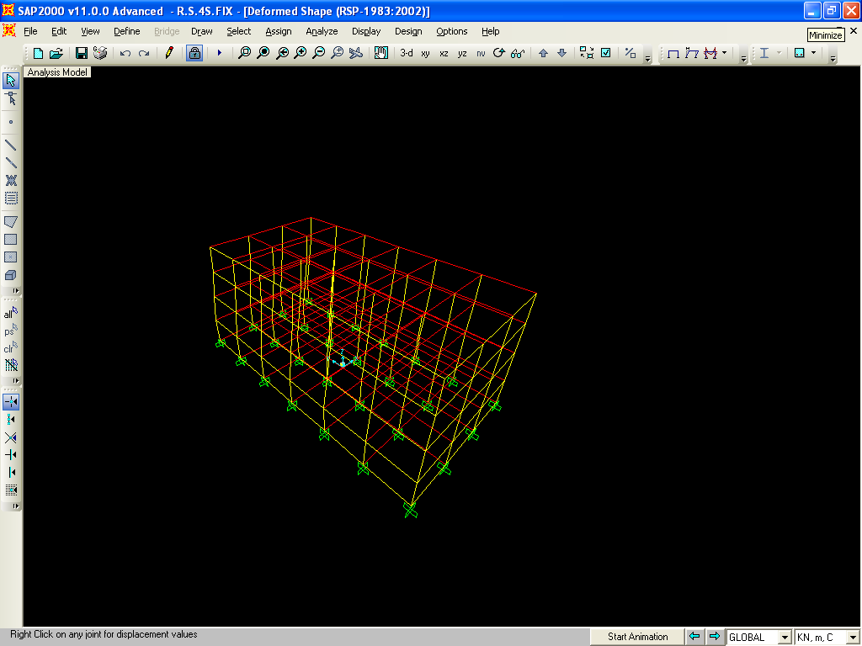
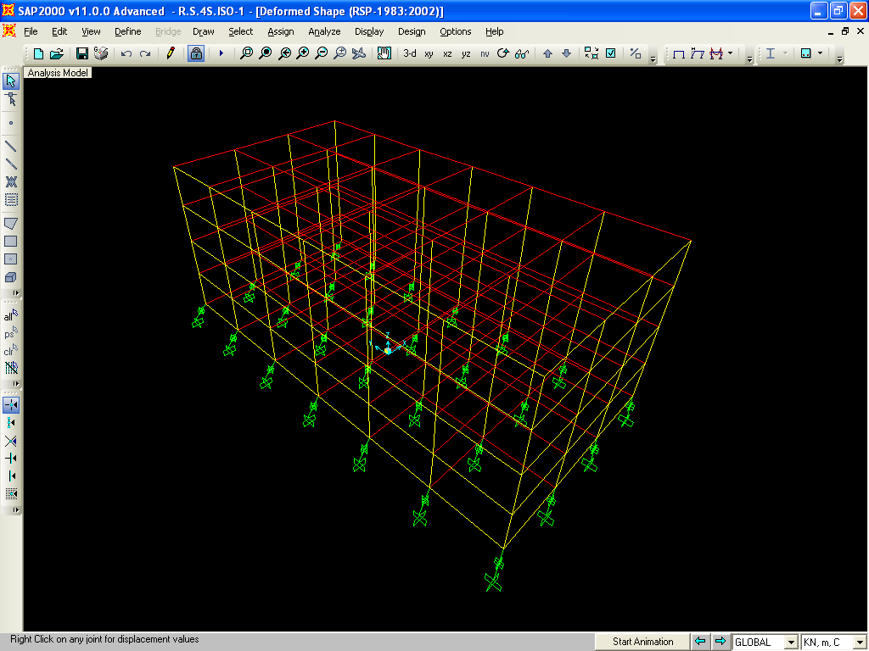
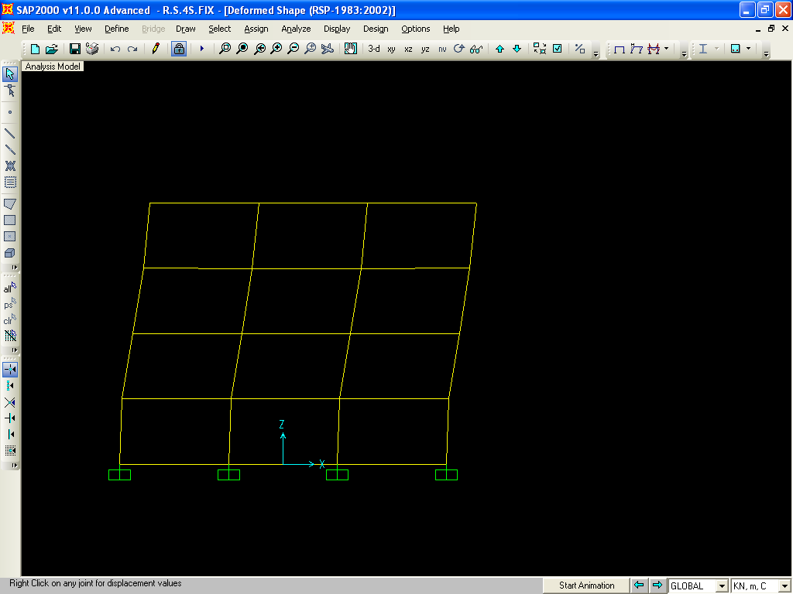
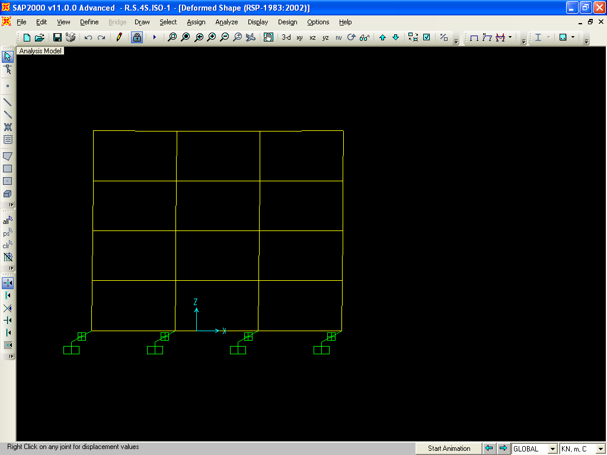
Fig.5.3
Ist mode shapes of 6 storeys Fixed base Building
Ist mode shapes of 6 storeys equal stiffness isolators base

Slide 9
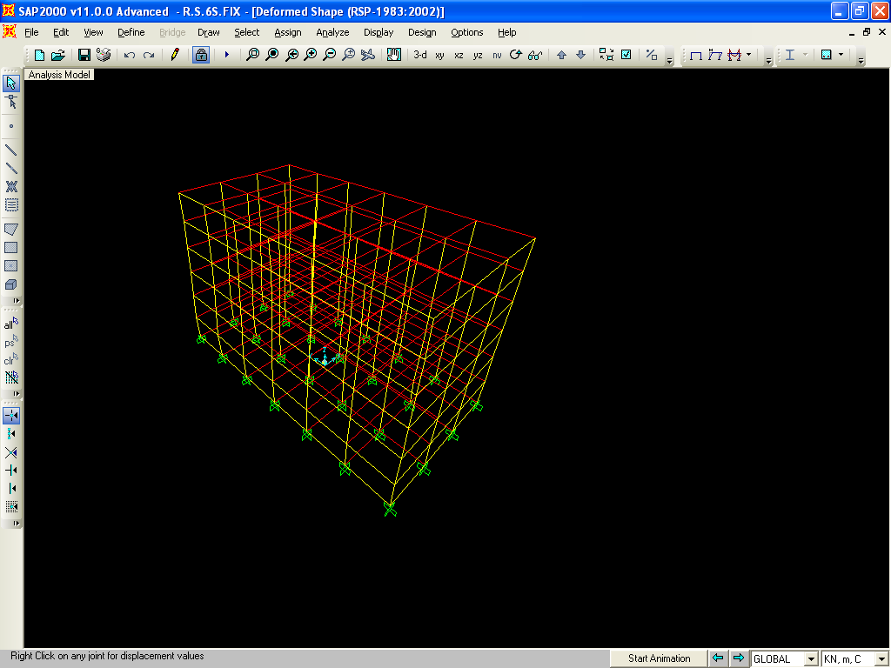
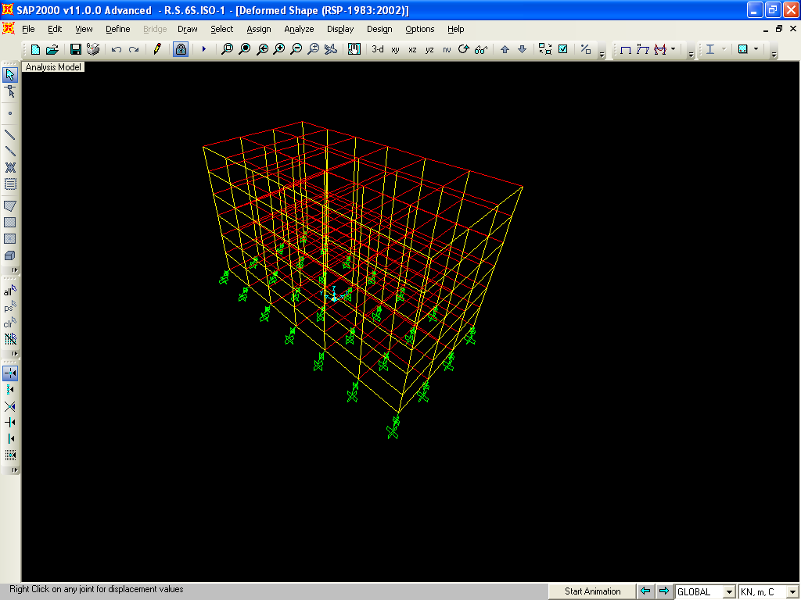
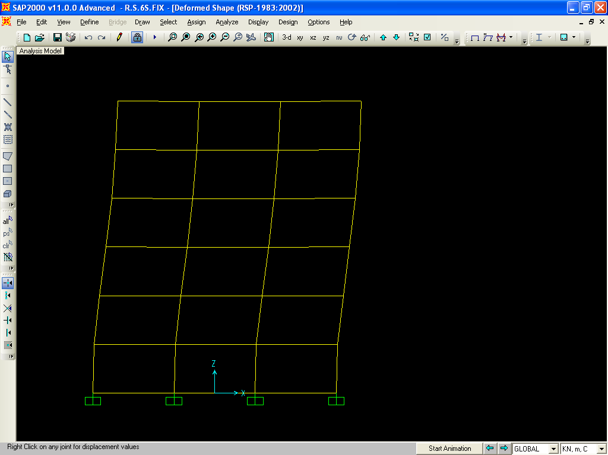
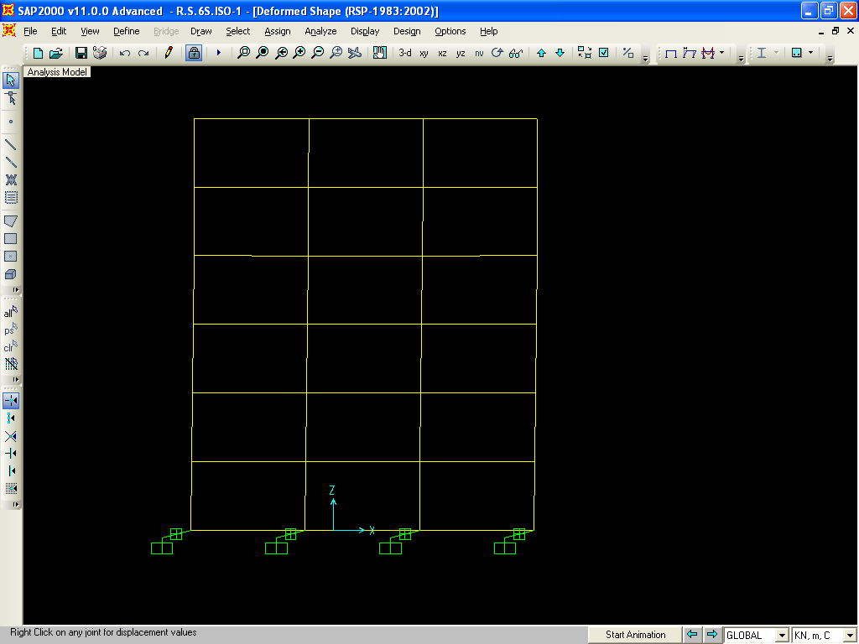
Ist mode shapes of 6 storeys Fixed base Building
Ist mode shapes of 6 storeys equal stiffness isolators base

Slide 10
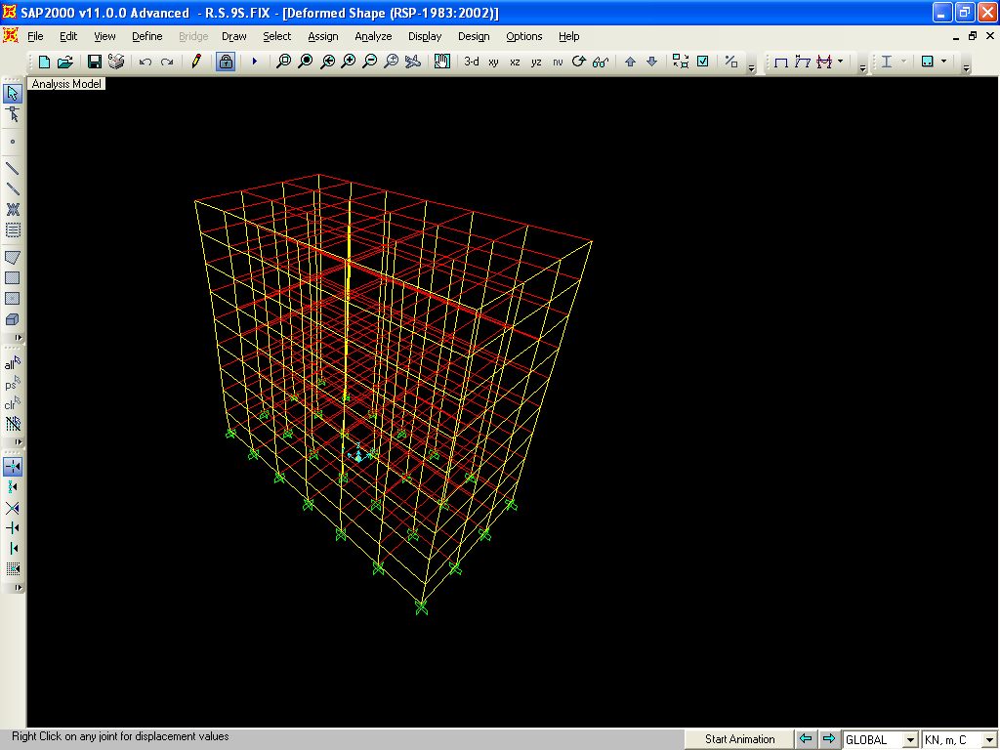
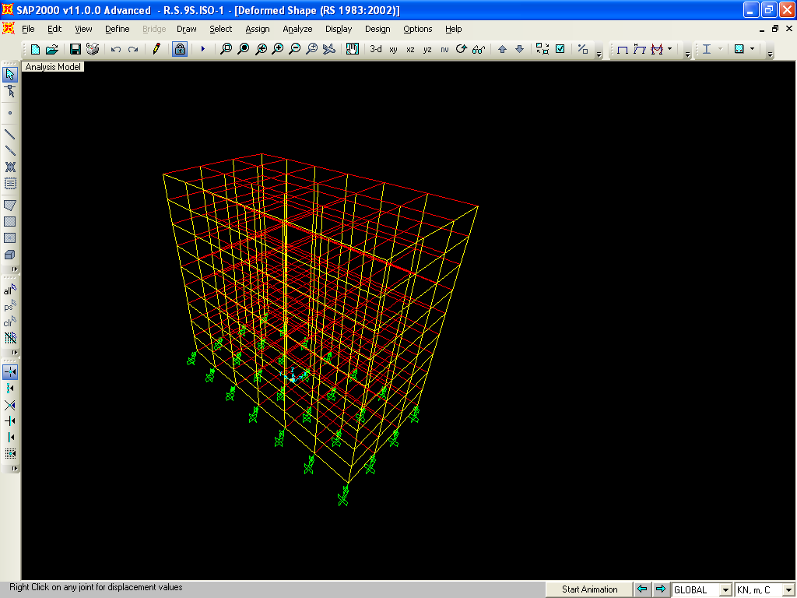
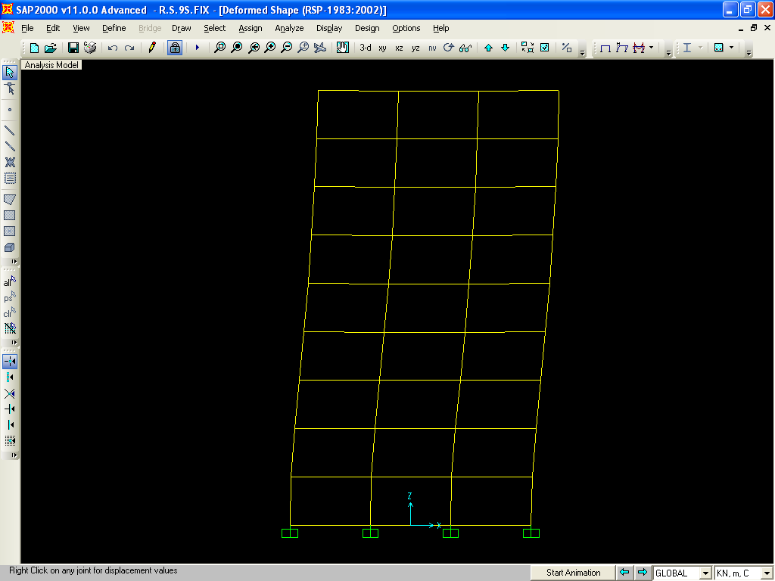
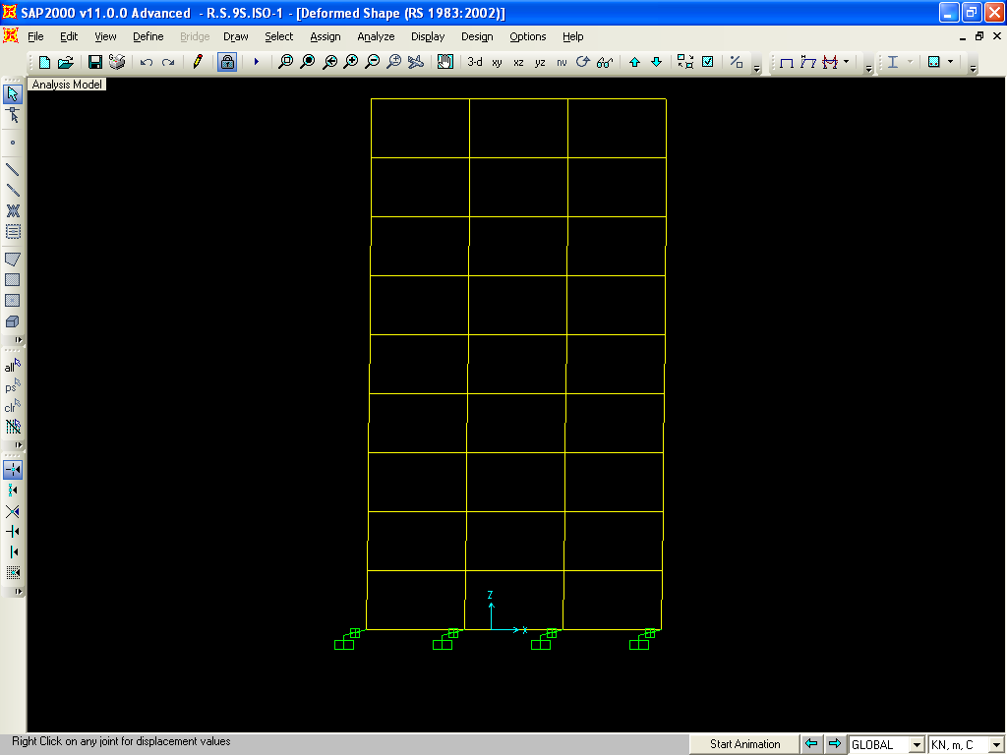
Fig.5.4
Ist mode shapes of 9 storeys fixed base
Ist mode shapes of 9 storeys equal stiffness isolators base

Slide 11
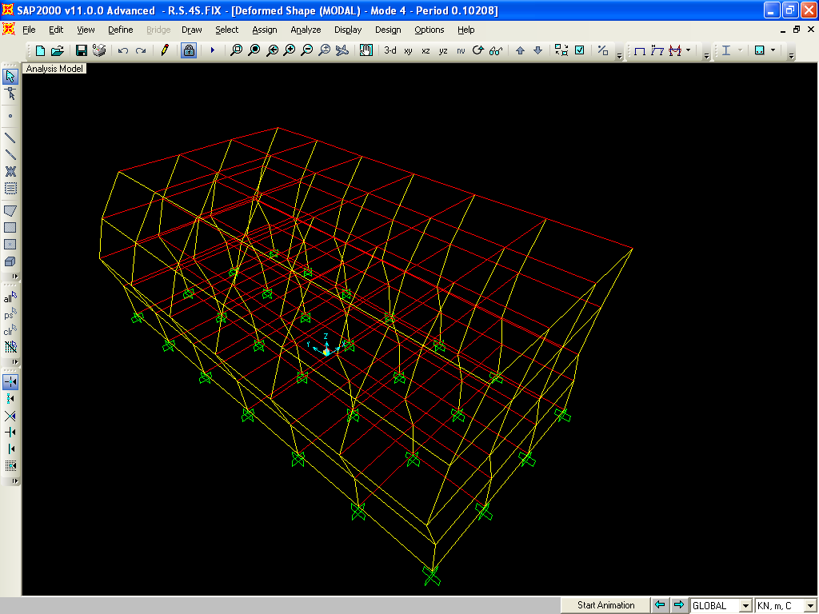
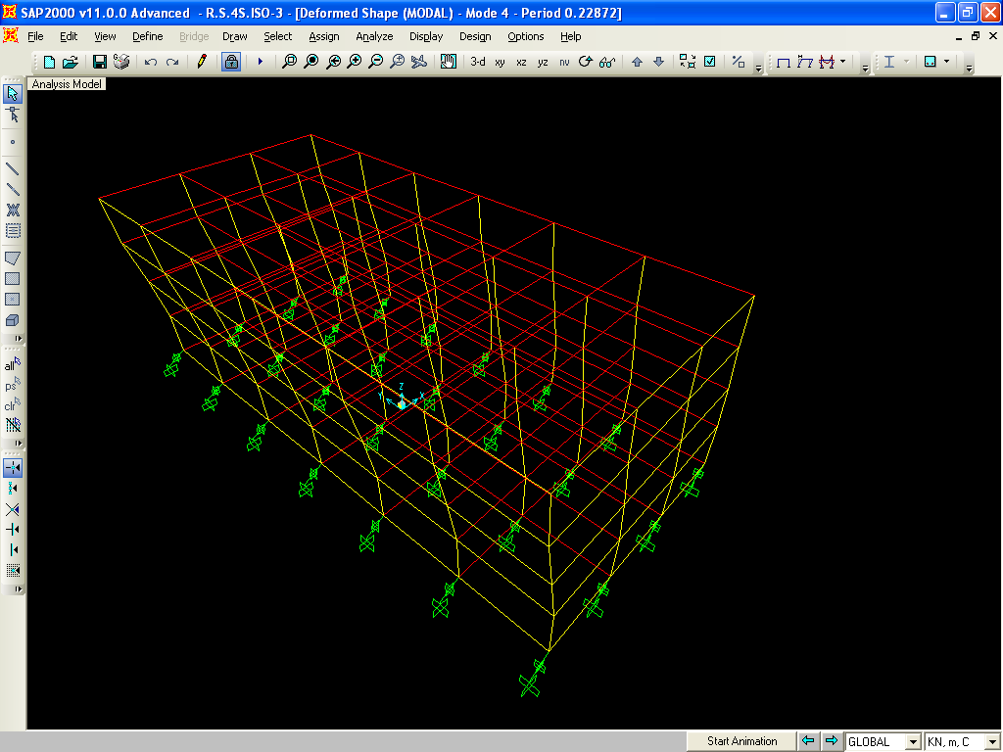
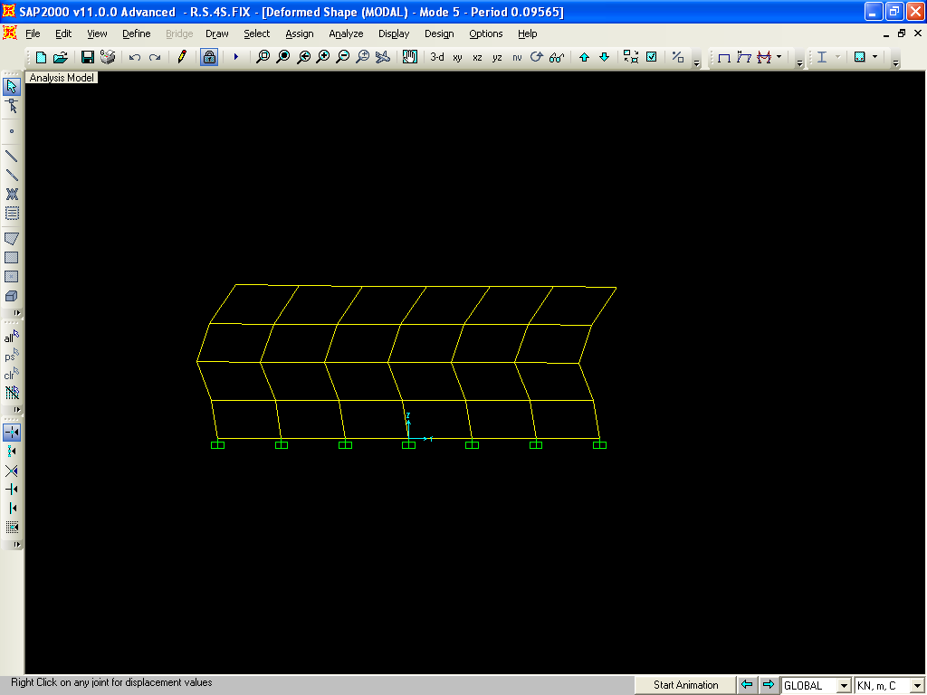
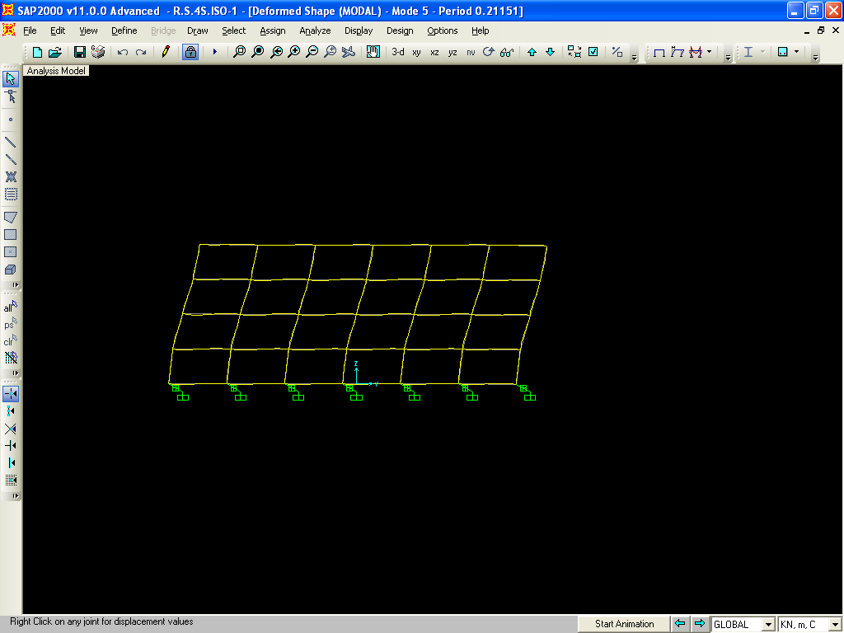
Fig 5.5
5th Mode shape of 4 Storey Fixed Base Building
5Th Mode Shape of 4 Storey Base-Isolated Building

Slide 12
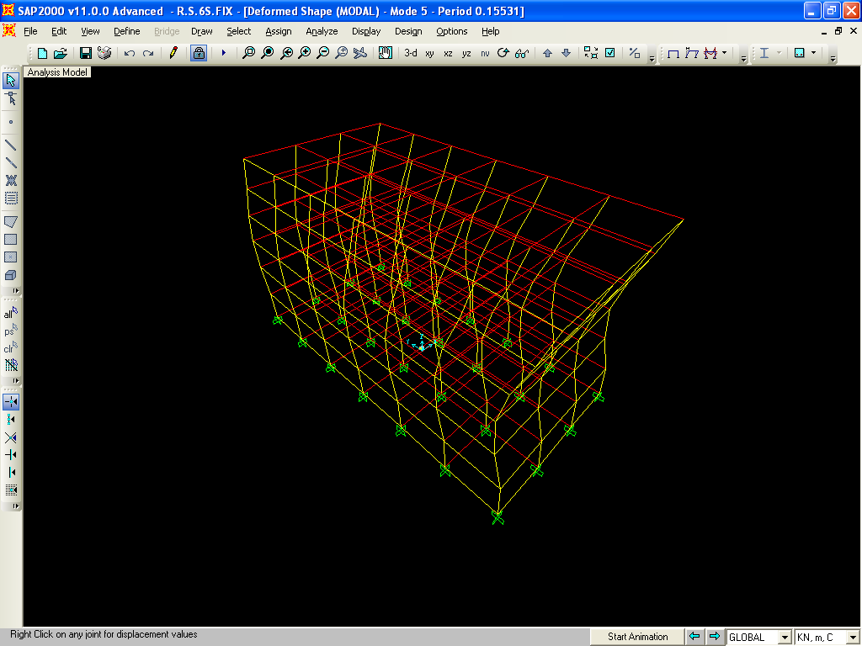
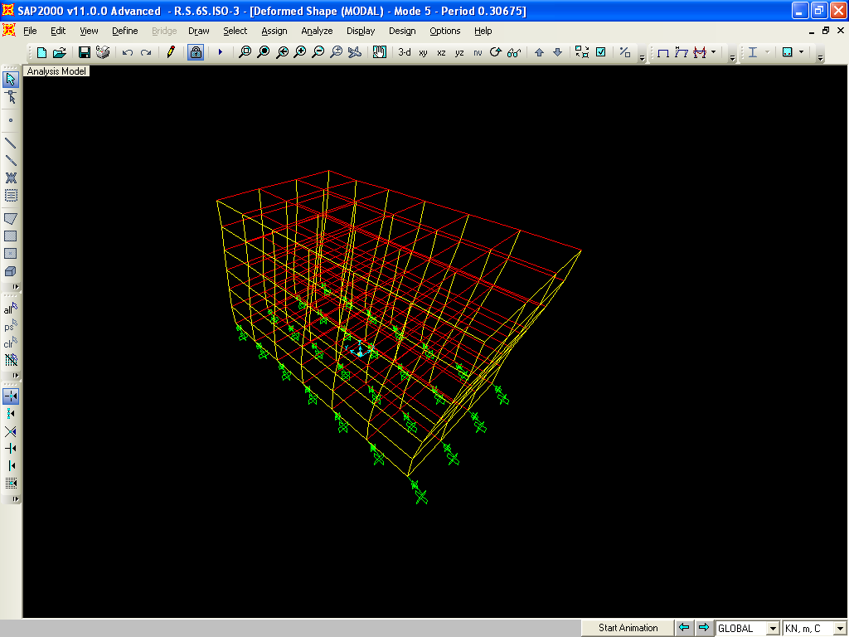
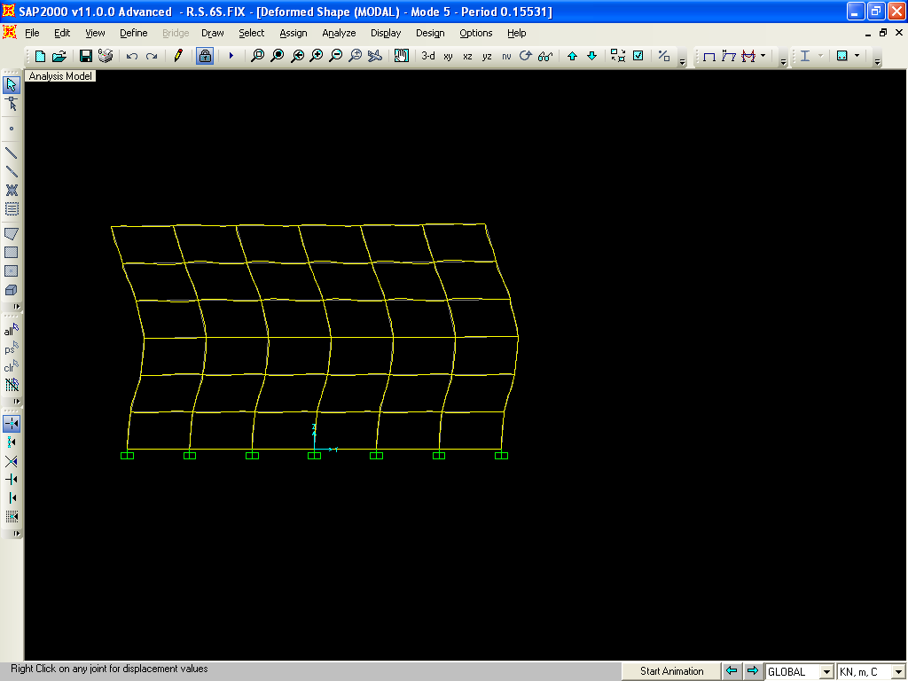
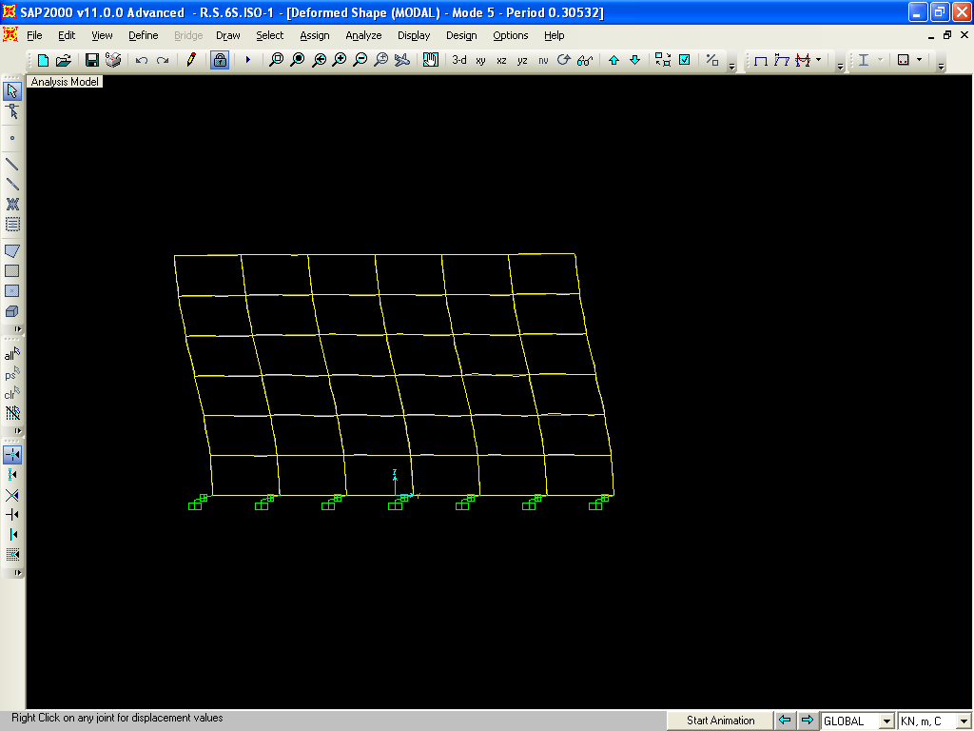
Fig 5.6
5th Mode Shape of 6 Storey Fixed Base Building
5th Mode shape of 6 Storey Base-Isolated Building

Slide 13
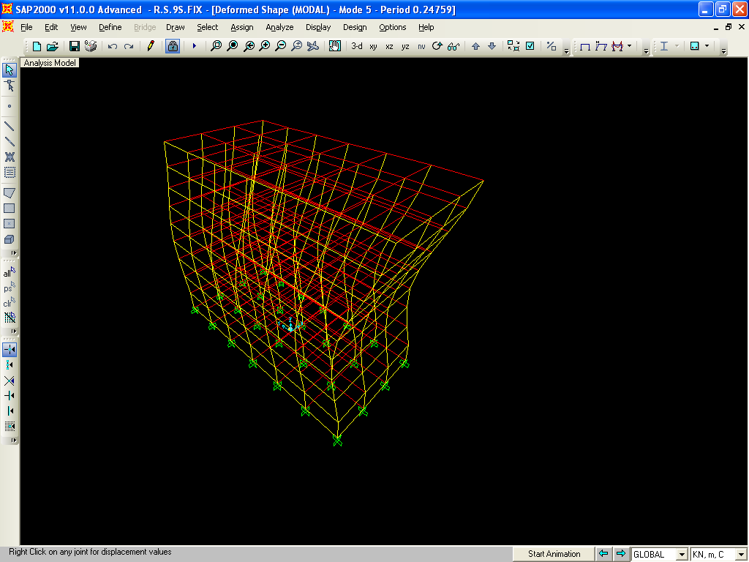
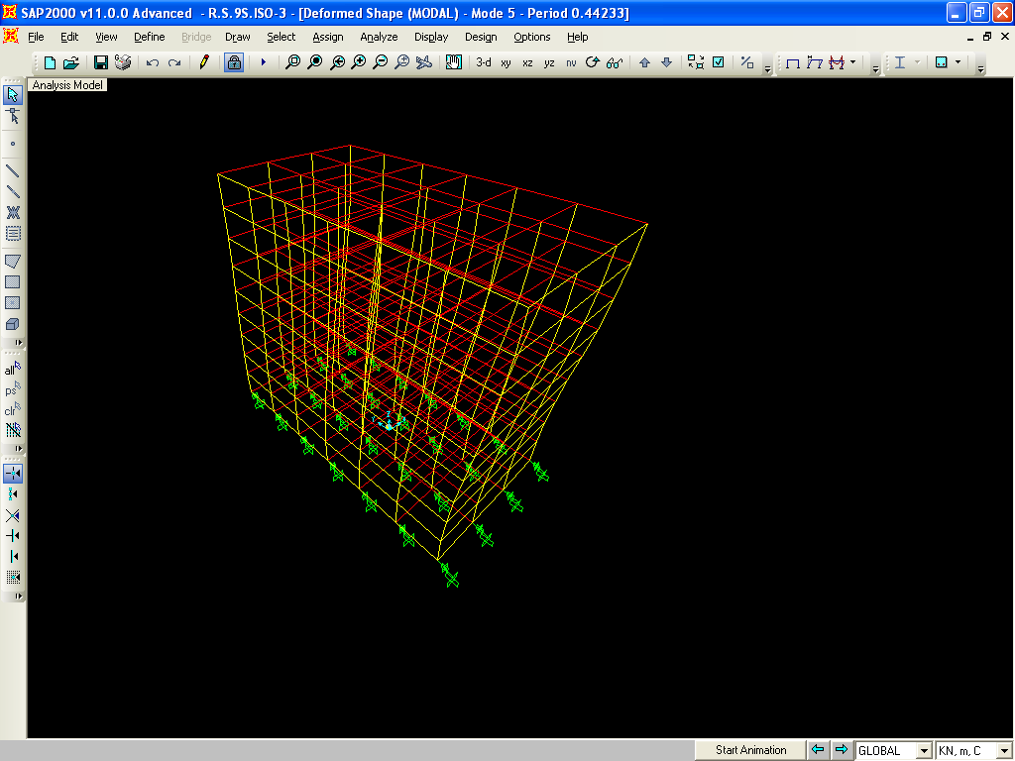
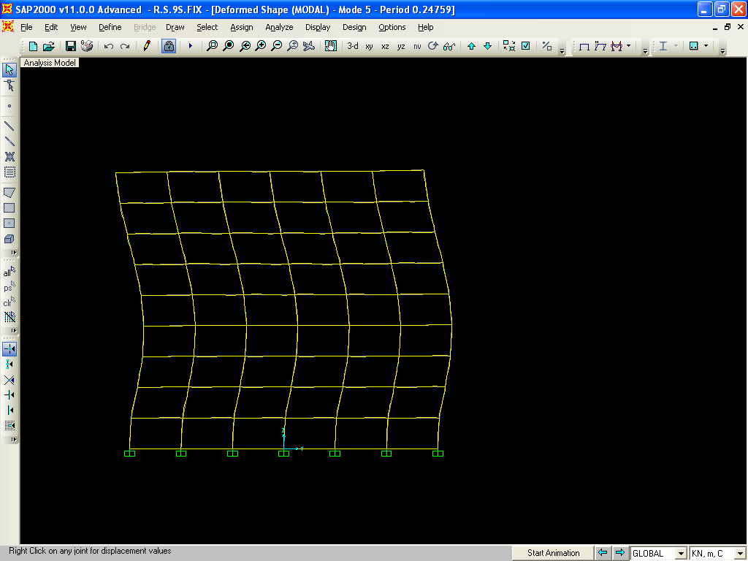
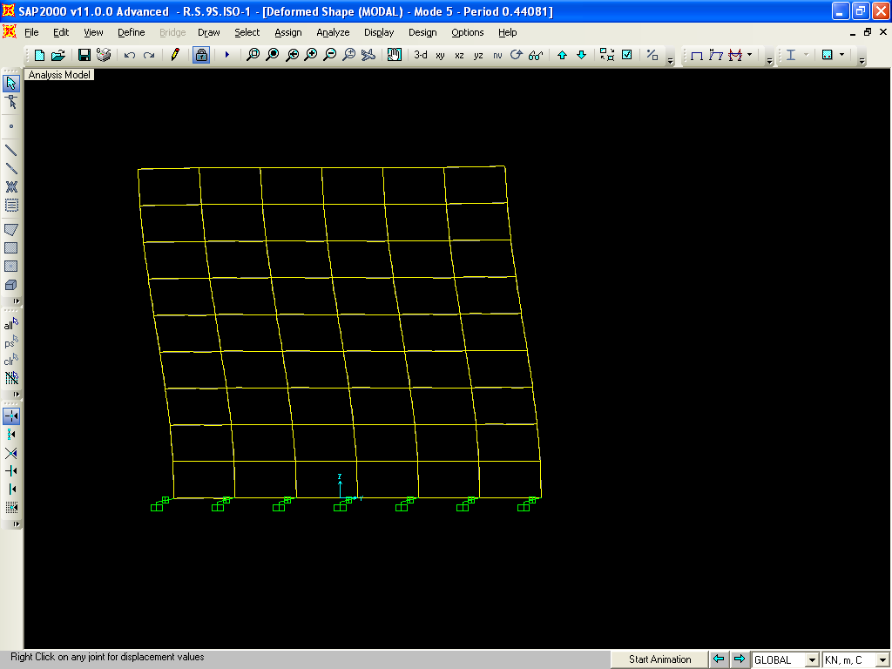
Fig 5.7
5th Mode Shapes of 9 Storeys Fixed Base Building
5th Mode shapes of 9 storeys equal stiffness Isolators base Building

Slide 14
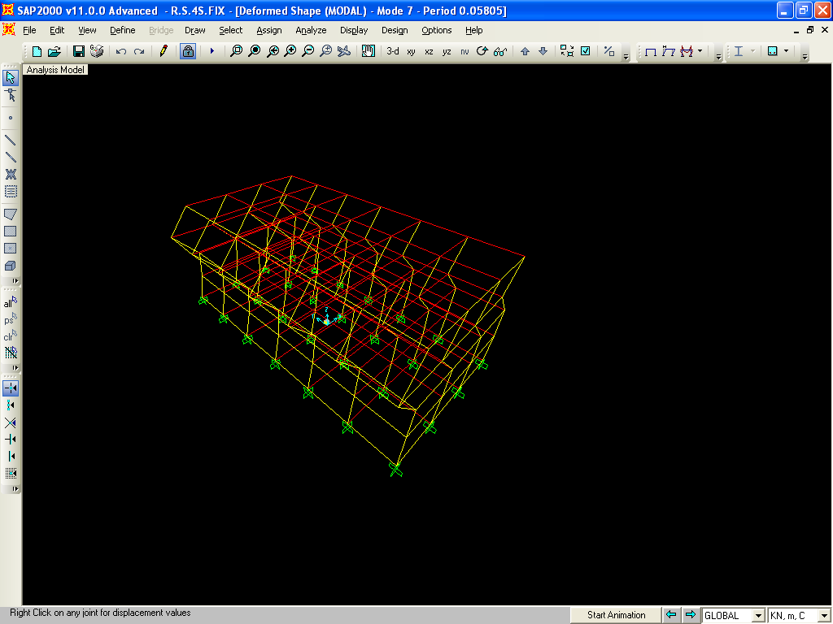
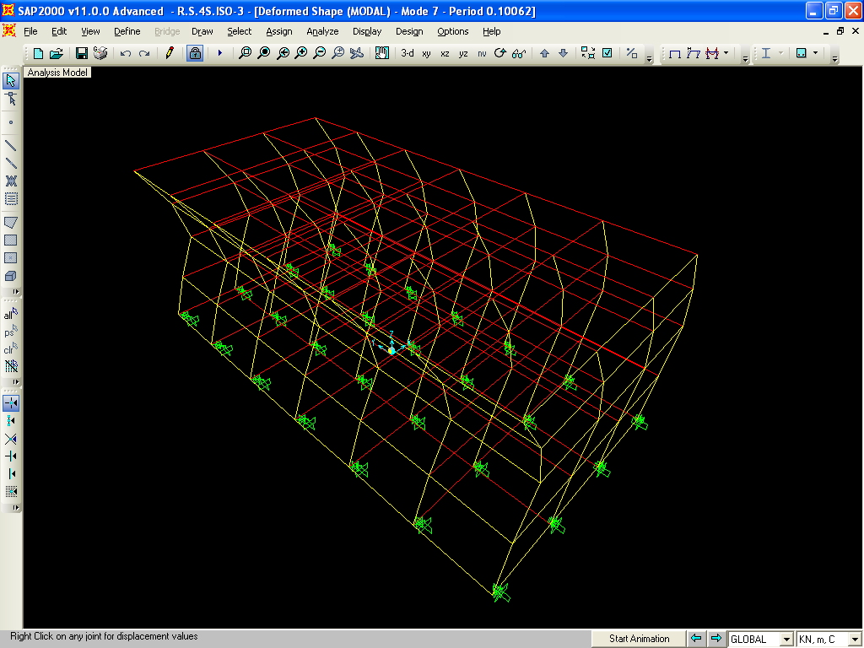
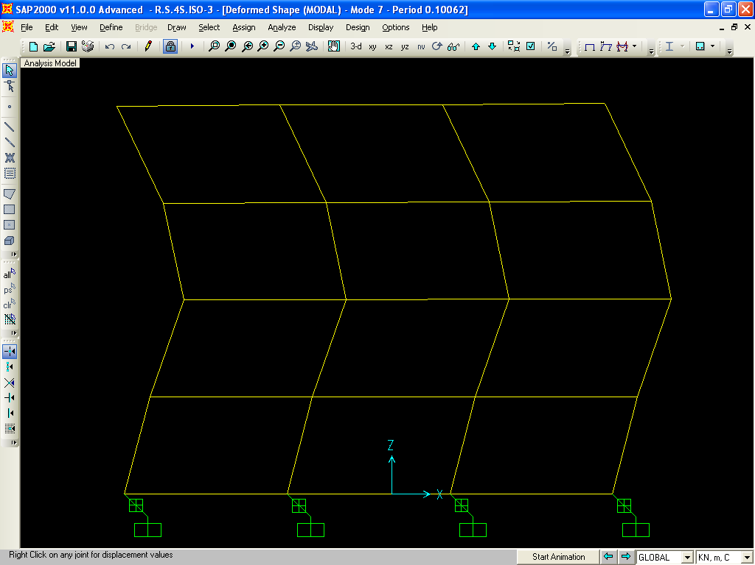
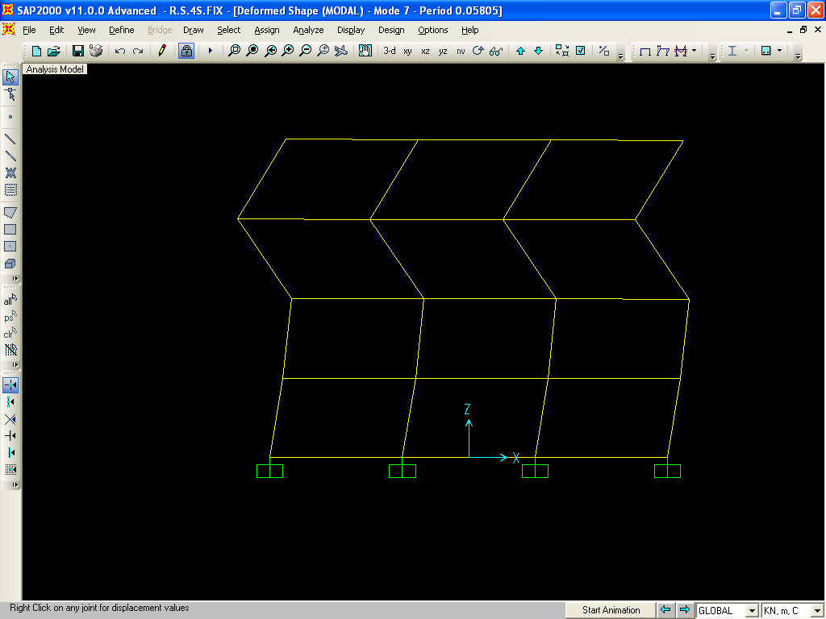
Fig 5.8
7TH MODE SHAPE OF FIXED BASE 4 STOREY BUILDING
7TH MODE SHAPE OF BASE-ISOLATED 4 STOREY BUILDING

Slide 15
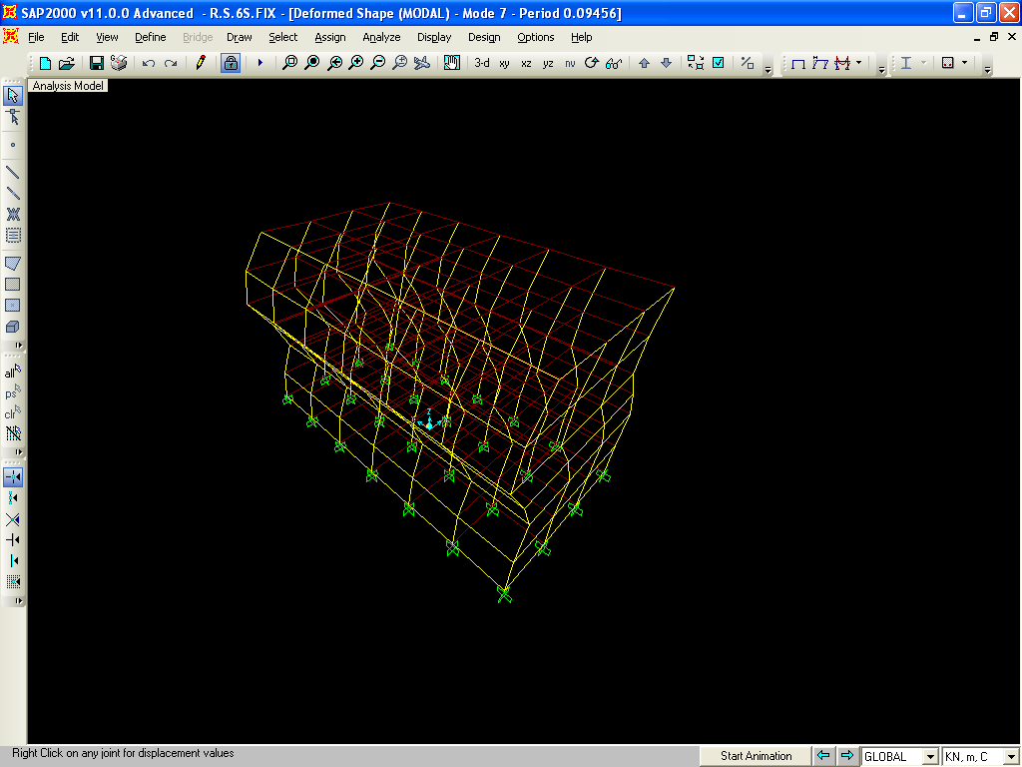
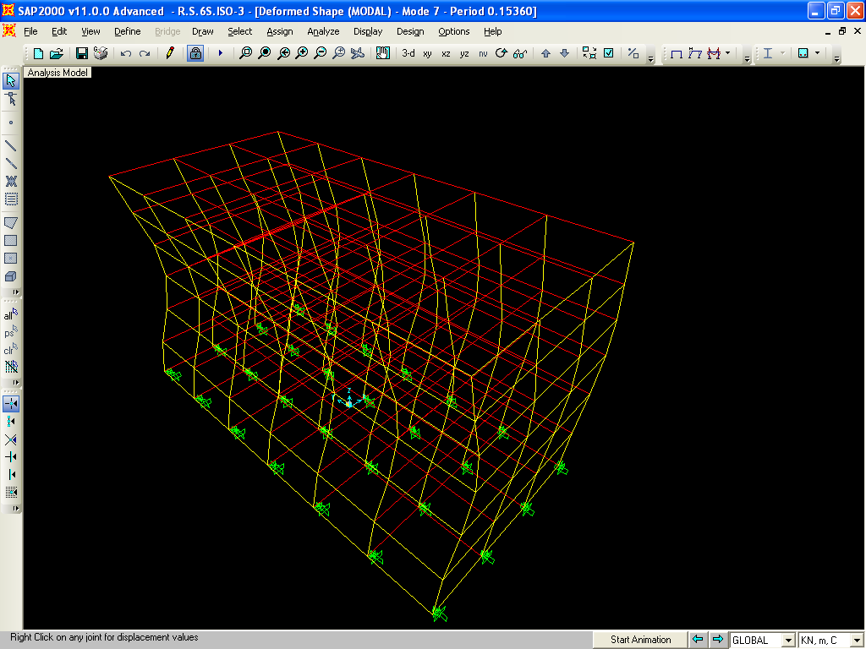
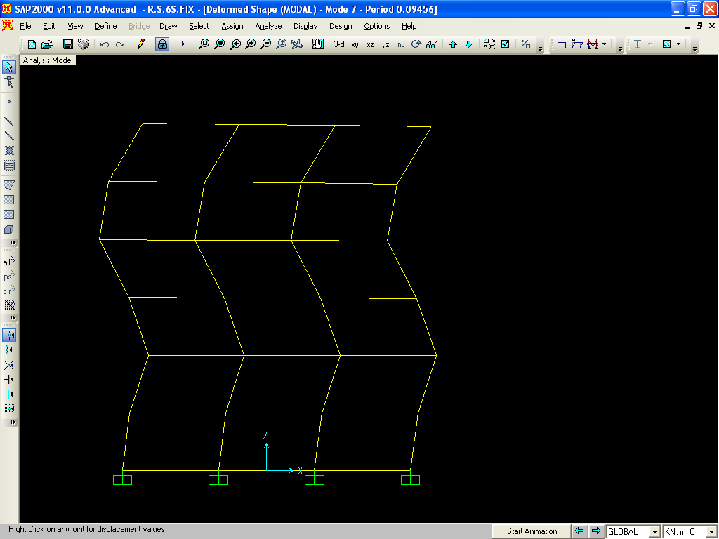
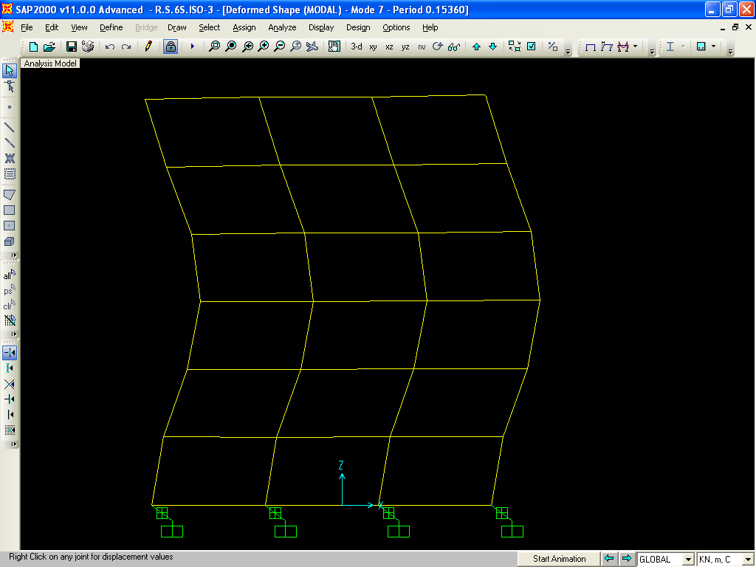
Fig 5.9
7TH MODE SHAPE OF FIXED BASE 6 STOREY BUILDING
7TH MODE SHAPE OF BASE-ISOLATED 6 STOREY BUILDING

Slide 16
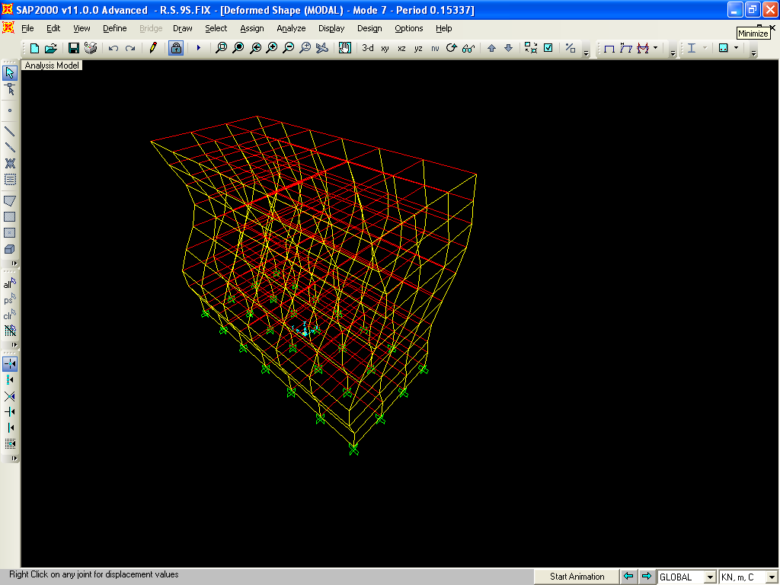
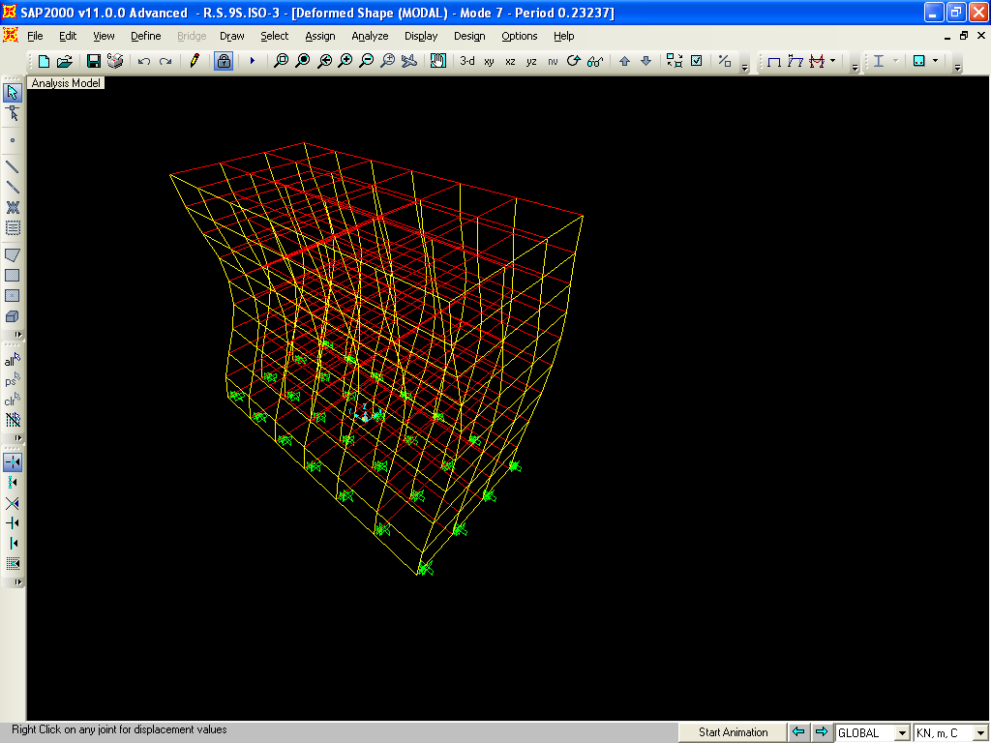
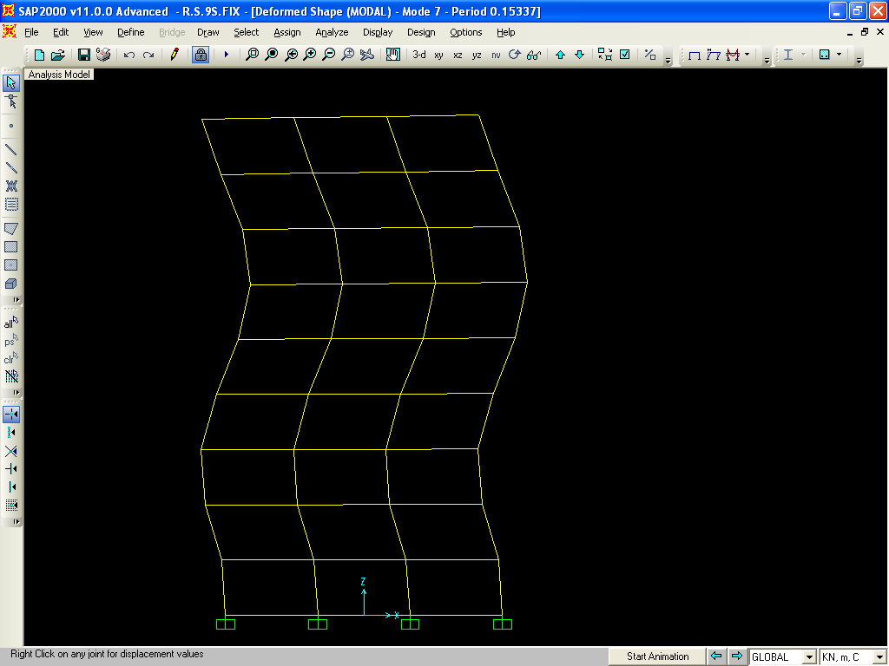
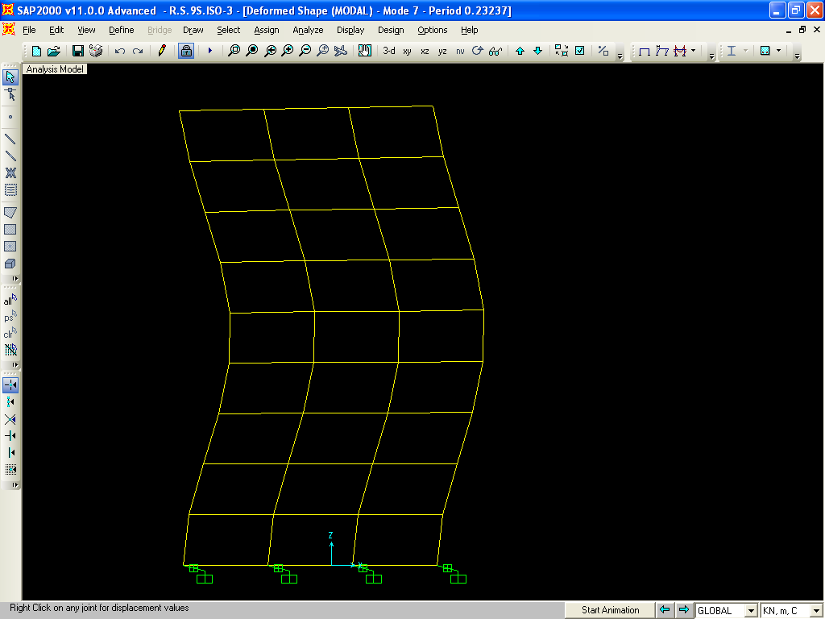
Fig.5.10
7TH MODE SHAPE OF FIXED BASE 9 STOREY BUILDING
7TH MODE SHAPE OF BASE-ISOLATED 9 STOREY BUILDING

