Slide 1
7.0 Discussion of results:
7.1 RESPONSE SPECTRUM CASES: Results obtained for the present study carried out using SAP 2000 v11 for time period (Table 5.1) clearly shows that the time period is being magnified up to as under follows:
4.84 times when comparing with uniformly isolated frame’s (T=1.5563 Seconds.) from the fixed one (T=0.3213Sec.) for four storey building
3.58 times when comparing with uniformly isolated frame’s (T=1.8550 Seconds.) from the fixed one (T=0.5181Sec.) for six storey building
2.75 times when comparing with uniformly isolated frame’s (T=2.2632 Seconds.) from the fixed one (T=0.8228Sec.) for nine storey building
The spectral acceleration & base shear will also correspondingly get reduced; this shows the effectiveness of seismic isolation. If we compare all the isolated cases, the maximum magnification in time period is observed in the case when isolators of different stiffness randomly placed are being used.
EFFECT ON BASE SHEAR: Results obtained for the present study carried out using SAP 2000 v11 for time period (Table 5.2) clearly shows that the base shear is being reduced as under follows:
38.19 % when comparing with uniformly isolated frame’s (V max=3307.55 KN.) from the fixed one (V max=5351.19.) for four storey building
53.08 % when comparing with uniformly isolated frame’s (V max=3833.13 KN.) from the fixed one (V max=8169.43 KN.) for six storey building
46.66% when comparing with uniformly isolated frame’s (V max=4483.19 KN) from the fixed one (V max=8405.13 KN) for nine storey building
If we compare all the isolated cases, the maximum reduction in base shear is observed in the case when isolators of different stiffness randomly placed are being used.
REDUCTION IN MAXIMUM SHEAR VALUES IN GROUND STOREY COLUMNS: Results shown in table 5.3 for column shear(kn)in ground storey columns show that on introduction of isolators to the fixed base frame the value of column shear is reduce as under follows.
50.42 % when comparing with uniformly isolated frame’s (V max=123.74 KN.) from the fixed one (V max=249.59 KN.) for four storey building
61.17 % when comparing with uniformly isolated frame’s (V max=150.44 KN) from the fixed one (V max=387.41 KN) for six storey building

Slide 2
53.77 % when comparing with uniformly isolated frame’s (V max=185.39 KN) from the fixed one (V= 401.00 KN) for nine storey building
The maximum reduction in ground column shear is observed in the case when isolators of different stiffness randomly placed are being used.
EFFECT ON RELATIVE TOP DISPLACEMENT : Results shown in table 5.4 For base and top displacement( in mm) show that on introduction of isolators to the fixed base frame the value of base to top relative displacement is reduce as under follows.
50.50 % when comparing with uniformly isolated frame’s (Displ. =9.80 mm) from the fixed one (D=19.80 mm) for four storey building
63.76 % when comparing with uniformly isolated frame’s (Displ.=18.70 mm) from the fixed one (D=51.60) for six storey building
57.36 % when comparing with uniformly isolated frame’s (Displ.=37.10 mm) from the fixed one (V=87.00 mm) for nine storey building
The maximum reduction in relative top displacement is observed in the case when isolators of different stiffness randomly placed are being used.
EFFECT ON INTER STOREY DRIFT: Results shown in table 5.5 For maximum inter storey drift values ( in mm) show that on introduction of isolators to the fixed base frame the value of inter storey drift is reduce as under follows.
51.38 % when comparing with uniformly isolated frame’s (Drift=3.50 mm) from the fixed one (D=7.20 mm) for four storey building
64.96% when comparing with uniformly isolated frame’s (Drift=4.10 mm) from the fixed one (D=11.70 mm) for six storey building
63.26 % when comparing with uniformly isolated frame’s (Drift= 5.40mm) from the fixed one (V=14.70 mm) for nine storey building
The maximum reduction in inter storey drift is observed in the case when isolators of different stiffness in column mass ratio are being used.
EFFECT ON MAXIMUM BENDING MOMENT: Results shown in table 5.6 For bending moment in column ( in KN-m) show that on introduction of isolators to the fixed base frame the value of maximum bending moment is reduce as under follows.
68.96 % when comparing with uniformly isolated frame’s (B.M. =216.67 KN-m) from the fixed one (B.M=698.12 KN-m) for four storey building

Slide 3
73.17 % when comparing with uniformly isolated frame’s (B.M=292.54 KN-m) from the fixed one (B.M. =1090.27 KN-m) for six storey building
67.18 % when comparing with uniformly isolated frame’s (B.M=371.34 KN-m) from the fixed one (B.M=1131.43 KN-m) for nine storey building
The maximum reduction in maximum bending moment (almost) is observed in the case when isolators of different stiffness randomly placed are being used.
7.2 TIME HIST0RY CASES:-
EFFECT ON TIME PERIOD: The results will be the same as RSP all cases.
EFFECT ON BASE SHEAR: The results will be the same as RSP all cases.
REDUCTION IN MAXIMUM SHEAR VALUES IN GROUND STOREY COLUMNS: Results shown in table 5.3 for column shear(kn)in ground storey columns show that on introduction of isolators to the fixed base frame the value of column shear is reduce as under follows.
46.55 % when comparing with uniformly isolated frame’s (V max=166.74 KN.) from the fixed one (V max=311.98 KN.) for four storey building
63.88 % when comparing with uniformly isolated frame’s (V max=206.34 KN) from the fixed one (V max=571.24 KN) for six storey building
56.02 % when comparing with uniformly isolated frame’s (V max=216.70 KN) from the fixed one (V= 492.79 KN) for nine storey building
The maximum reduction in column shear is observed in the case when isolators of different stiffness randomly placed are being used.
EFFECT ON RELATIVE TOP DISPLACEMENT : Results shown in table 5.4 For base and top displacement( in mm) show that on introduction of isolators to the fixed base frame the value of base to top relative displacement is reduce as under follows.
59.23 % when comparing with uniformly isolated frame’s (Displ. =11.70 mm) from the fixed one (D=28.70 mm) for four storey building
74.40 % when comparing with uniformly isolated frame’s (Displ.=23.3 mm) from the fixed one (D=91.00mm) for six storey building

Slide 4
51.45 % when comparing with uniformly isolated frame’s (Displ.=52.00 mm) from the fixed one (V=107.10 mm) for nine storey building
The maximum reduction in relative top displacement is observed in the case when isolators of different stiffness randomly placed are being used.
EFFECT ON INTER STOREY DRIFT: Results shown in table 5.5 For maximum inter storey drift values ( in mm) show that on introduction of isolators to the fixed base frame the value of inter storey drift is reduce as under follows.
61.17 % when comparing with uniformly isolated frame’s (Drift=4.0 mm) from the fixed one (D=10.3 mm) for four storey building
70.87 % when comparing with uniformly isolated frame’s (Drift=6.00 mm) from the fixed one (D=20.60 mm) for six storey building
47.67 % when comparing with uniformly isolated frame’s (Drift= 9.00 mm) from the fixed one (V=17.20 mm) for nine storey building
The maximum reduction in inter storey drift is observed in the case when isolators of different stiffness in column mass ratio are being used.
EFFECT ON MAXIMUM BENDING MOMENT: Results shown in table 5.6 For bending moment in column ( in KN-m) show that on introduction of isolators to the fixed base frame the value of maximum bending moment is reduce as under follows.
59.29 % when comparing with uniformly isolated frame’s (B.M. =352.21 KN-m) from the fixed one (B.M=866.01 KN-m) for four storey building
74.62 % when comparing with uniformly isolated frame’s (B.M=408.26 KN-m) from the fixed one (B.M. =1608.61KN-m) for six storey building
67.28 % when comparing with uniformly isolated frame’s (B.M=454.49 KN-m) from the fixed one (B.M=1389.00 KN-m) for nine storey building
The maximum reduction in maximum bending moment (almost) is observed in the case when isolators of different stiffness randomly placed are being used.

Slide 5
8.0CONCLUSION:
On the basis of numerical study & discussions of results obtained after analysis, following conclusions were drawn:
Base isolation substantially increases the time period of structure & hence correspondingly reduces the base shear. As observed in the present study (Table 5.1 & 5.2) the time period is being increased up to 4.84,3.58 &2.75 times for 4,6 & 9 Storey buildings respectively while base shear is reduced 38.19,53.08 & 46.66 % respectively 4,6 & 9 Storey Buildings to of that of fixed one theirs.
As far as the relative top displacement & maximum inter storey drifts are concerned, In this present study, the results obtained suggest that the case 3 i.e. the when the different stiffness of isolators are gives lower relative top displacement & maximum inter storey drifts as compared to case 2 i.e. uniform isolator stiffness.
The top displacement time histories for fixed & isolated cases conspicuously shows the magnification of time period in case of base-isolated structure., the base shear value will get reduced corresponding to the increased time period of the structure.
Based on the study carried out & discussion of results it is observed that how effective seismic isolation is considering various aspects such as: base shear, inter storey drifts, maximum bending moments & column shears etc. Analysis results of the study suggest that isolators of uniform stiffness are better option as compared to isolators of stiffness in ratio of column load, due to cost/availability, and structure safety is concerned.
In designing of laminated rubber bearing isolator, the rubber shear modulus G, lead diameter Dp, diameter of bearing D, numbers of rubber layers and steel properties play an important role
In designing of laminated rubber bearing isolators. Imperial constant k used in calculation of compression modulus (For capacity calculation) and vertical stiffness modulus is kept,0.9 when G<0.050 ksi, 0.85 when G< 0.070 ksi,0.75, when G<0.090ksi and 0.65 when G<0.015 ksi. This has been shown in design part of Isolators

Slide 6
9.0 FUTURE SCOPE &RESEARCH OF BASE ISOLATION:
There is a lot of scope to explore the much-much needed requirement of base isolation to save human life etc. In the presented scope work, the following parameters studies are being carried out.
1. Effect of base-isolation on 1st, 5th and 7^{th,} mode of vibration.
2. Effect of high of building on base isolation up to 12 m height’s building.
3. Effect of high of building on base isolation up to 15 m height’s building.
4. Effect of high of building on base isolation up to 27 m height’s building.
5. Superstructure to be assumed perfectly rigid for study.
6. Analysis and design parameter of laminated rubber bearings
7. Laminated rubber bearing had enough compressive strength (to support the building)
What are scope and research required for following parameters?
1. Effect of base-isolation on higher mode of vibration.
2. Effective base-isolation of superhigh-rised buildings
3. Effect of superstructure flexibility, stiffness variation and extent of eccentricity
4. Analysis and design parameter of high strength rubber bearings, which also counter pull-out forces at the lower ends of columns during a major earthquake
5. Effect of “Flat slab base isolation system/mega beams on base-isolation of high-rise buildings.
6. Base-isolation of buildings whose aspect ratio [ratio of building (H) to building width (W)] is higher than 3.
Only for 1st mode of vibration, the effect of higher modes on structure, parameters based on eccentricity or superstructure stiffness variation /superstructure flexibility etc. have to be analyzed. It has been observed in my present work that base isolation is more effective on low rise-buildings while superstructure is assumed to be perfectly rigid for the study. How base isolation may be effective in high –rise building is also a research work. Hence in our country a lot of research work can be done & needed to be done.
9.1. Work done on, High-Rise Base-Isolated Buildings in Japan.
9.1.1 Flat Slab Base-Isolated High-Rise Condominium Building: - Takenaka Corporation, has designed and constructed flat slab base-isolated high-rise condominium in Japan, naming “Sagahamihara-Hashimoto,Area Ownership Condominiums” having four tower. Maximum height 99.95m Using a medium-to high-rise Flat Slab Base-Isolation System, enabling free room layout, open and bright rooms with large windows.

Slide 7
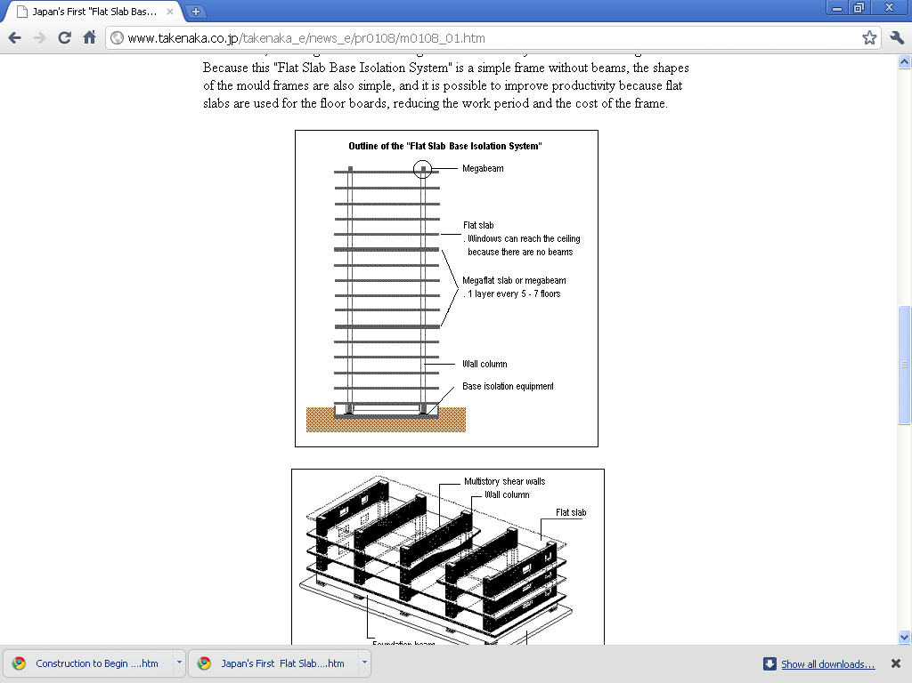
The building’s natural period has been increased to between four to six second by using a base isolation system, thereby greatly reducing the swaying (Maximum acceleration) of building during an earthquake to about one-third to one-quarter. By doing so, the superstructure of buildings use simple frames consisting of columns, floors and multi-storey shear walls. Also, mega structures have been built in the top floor and certain other floors, with mega beams maintaining the structural safety of the entire building. Partly construction arrangement shown in the following figure.
(From Takenaka.co.Japan)
Fig 9.1

Slide 8
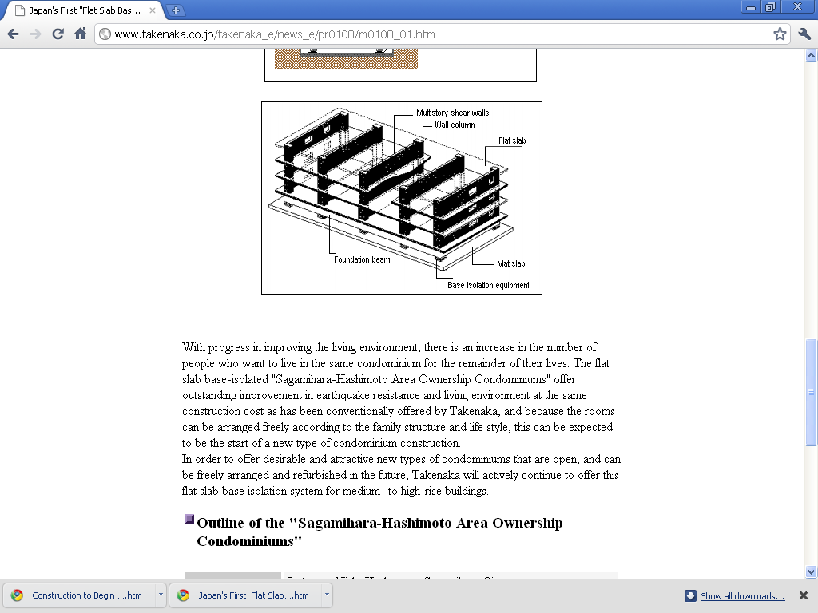
INTERNAL CONSTRUCTION OF FLAT SLAB BASE-ISOLATED BUILDING
Fig from (From Takenaka.co.Japan)
Fig 9.2

Slide 9
9.1.2 Tallest Base-Isolated Super high -Rise Condominium Building:-Takenaka Corporation has constructed 102.95 meters with 29 floors base-isolated building named ‘’Moto-Azabu 1-Crome Plan” tallest base-isolated super high-rise condominium building using base isolation technology.
In this building Takenaka developed NSC (New SC) beams are “SC beams without fireproof coating on the bottom flange,’’ enabling the floor height to be reduced by the amount of the covering concrete of the bottom flange on the beam, or the ceiling to be increased by that amount. Two type of bearings for base isolation have been used in this building .Although contemporary rubber bearings had enough compressive strength (to support the building),they only had a small resistance strength against pull-out force(the power to pull the columns up).Rising 102.95 meters, this building is not only the highest base-isolated condominium building in the word, but pull-out force also works at the lower ends of the columns during a major earthquake. Therefore, high strength rubber bearing with resistance to pull-out force developed using Takenaka’s own technology are being used around the circumference of the building. The upper section of this super high-rise condominium building, where there is a good view, is in a widened plan shape, for this type shape to be possible, CFT( concrete filled tube) column construction is being used in the main body of the structure, and the outer span of the lower part is being extended to give the structure more stability.
Base-Isolation technology is also effective for super high-rise around 100 meters structures. Generally, super high-rise buildings are structurally soft, have flexibility strength, and are effective against earthquakes because the vibration period is long (so they shake slowly).With superhigh-rise buildings (around 100 meters in height) like this, by using base isolation technology,the vibration period of the building can be lengthened, thereby further reducing the shaking in the residential sections
Base-isolation layer is built in between the basement 2nd and 3rd floors in the said building. High Strength Rubber Bearing(HSR)with a diameter of 140 centimetres have been installed at 16 locations around the circumference of the building where a large pull-out force can be expected, and rubber bearing with leads plugs (LRB) have been installed at 20 locations in the central part of the building. The maximum pull-out resistance strength of one High Strength Rubber (HSR) bearing is 450 MT. By using base-isolation technology in super high –rise buildings, the shaking of the building during an earthquake is reduced to between one-third to one-half.
High strength Rubber (HSR) Bearings are made with alternate layer of rubber and steel sheets enabling them to not only have a high load bearing capacity, but also to have a horizontal softness,thereby greatly reducing the horizontal vibration of building during an earthquake. Carbon

Slide 10
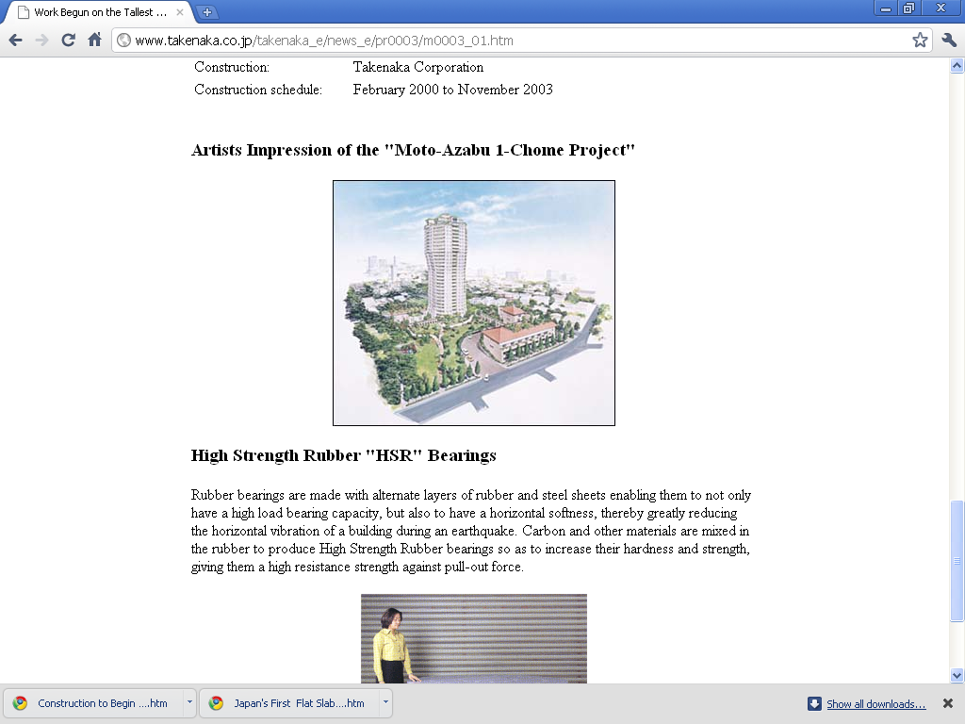
and other material are mixed in the rubber to produce High Strength Rubber bearings so as to increase their hardness and strength, giving them high resistance strength against pull-out force. Figures of Building and Bearing shown in below figures.
Fig of “ Moto-Azabu 1 –Chome Plan” Japan
From Takenaka.co.Japan web.
Fig 9.3

Slide 11
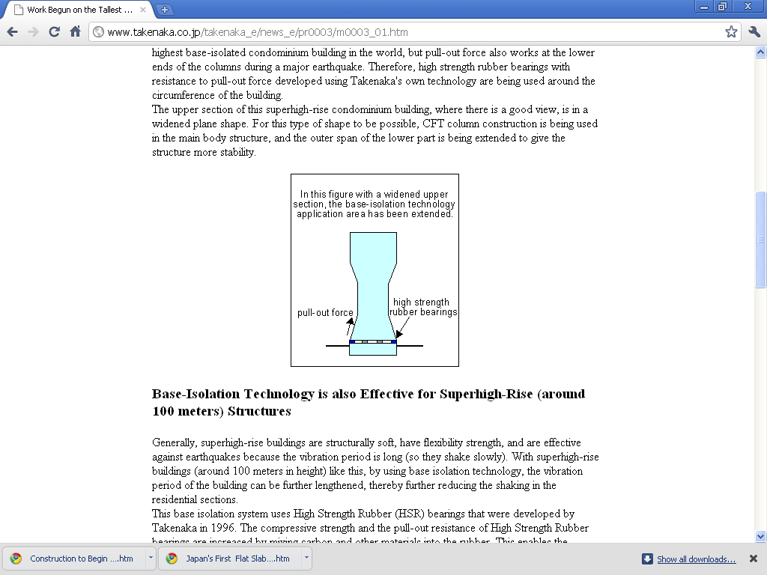
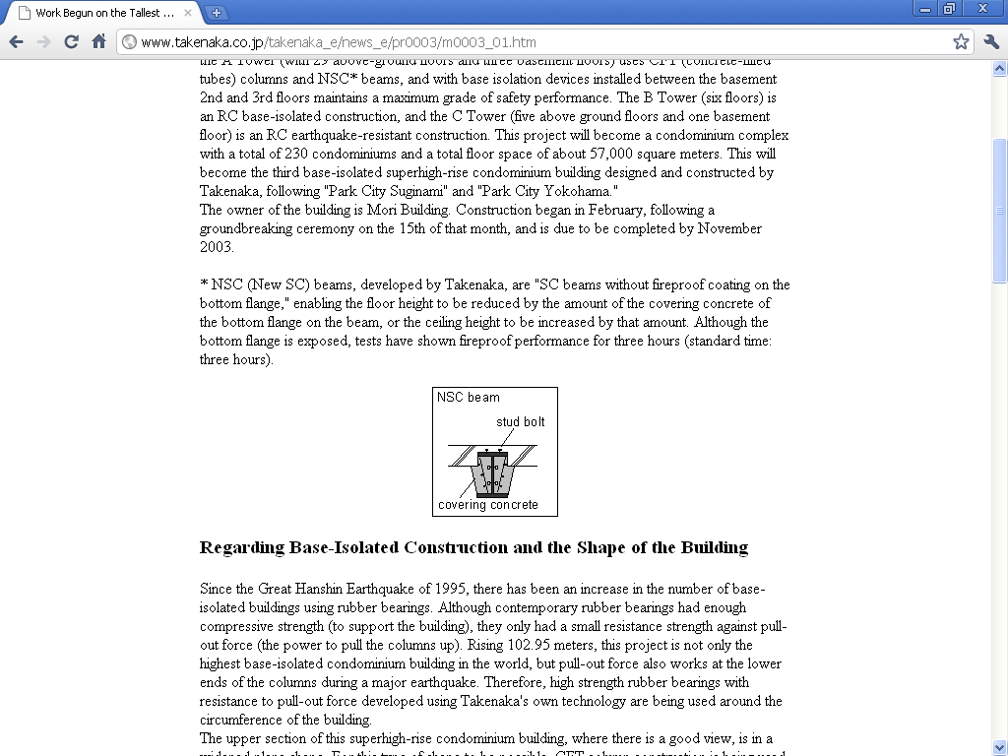
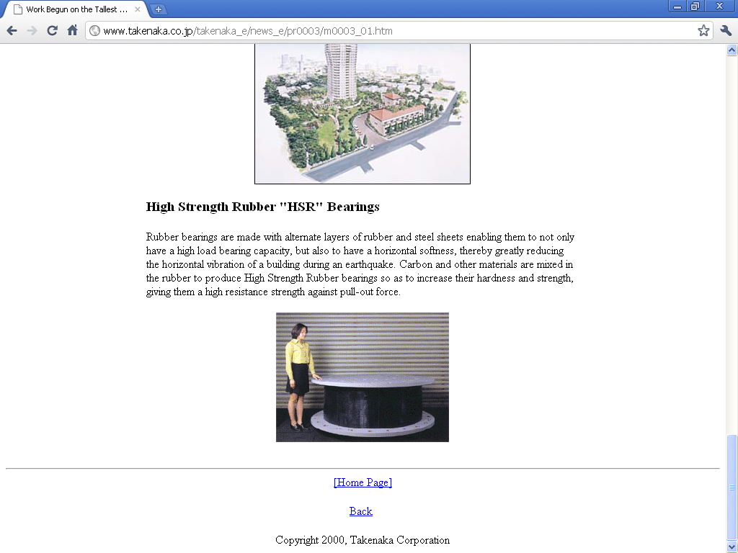
Fig 9.4
Fig 9.5
Fig9.6
Fig of “ Moto-Azabu 1 –Chome Plan” Japan
From Takenaka.co.Japan web.

Slide 12
REFERENCES
[1] Analysis Reference Manual: SAP 2000, CSI (Computers & Structure, Inc.), Berkeley, California, USA, January 2007.
[2] ATC-40(Vol.1 &2) Seismic Evaluation and retrofit of concrete buildings (1996).
[3] Chopra Anil K., Dynamics of Structures: Theory & Application To earthquake Engineering. 2nd edition, Prentice Hall Of India (2005)
[4] Cetin Yilmaz, Edmund Booth & Chris Sketchley “Retrofit of Antalya Airport International terminal building, Turkey using Seismic Isolation”. Paper no.1259, First European conference on earthquake Engineering & Seismology. Geneva, Switzerland, 3-8 September 2006.
[5] Fa-Gung Fan and Goodarz Ahmadi, “Multi-story base-isolated buildings under a harmonic ground motion -Part I: A comparison of performances of various systems.” Department of Mechanical and Industrial Engineering. Clarkson University, Potsdam, New York, US, June, 1989.
[6] Hart D.G., Chapter 8th, Base isolation.(1991)
[7] Hwang, Wu, Pan, Yang (2002) “A mathematical hysteretic model for elastomeric-isolation bearings”.
[8] International Building Code 2003.
[9] International Building code 2006.
[10] IS 1893-2002 part I: “Criteria for Earthquake Resistant Design of Structures” Part 1: General provisions & Buildings (Fifth revision), Bureau of Indian Standards, and New Delhi, India.
[11] Naeim Farzad & Kelly Treavor, “Design of Seismic Isolated Structures: From theory to practice”,1999, John Wiley & Sons, Inc., New York.
[12] Pankaj Agarwal, Manish Shrikhande. IIT] “Roorkee, Earthquake Resistant Design of structures”. prentice-hall of India Pvt.Ltd.New Delhi-110001, 2006.

Slide 13
[13] Oliveto & marletta, “Seismic Retrofitting of Reinforced Concrete Buildings Using Traditional and innovative Techniques”, ISET Journal, paper no. 545, (2005).
[14] Pandit sachin, “Structural Rehabilitation by Stiffness Strengthening & Base Isolation” IIT Delhi, 2005.
[15] Skinner, Robinson & Mc Verry , “An Introduction To Seismic Isolation”, 1993, John Wiley & Sons, Inc., Wellington, New Zealand.
[16] Sajal kanti deb (IITG) “Seismic isolation: an overview”,(2004).
[17] Tervor E. Kelly, S.E (2001) “Base Isolation of Structures: Design guidelines” Holmes consulting Group Ltd.
[18] T.K.Dutta, IIT Delhi, India, “Seismic Analysis of Structures”, ©2010, John Wiley & Sons (Asia) Pte Ltd.
[19] Uniform Building Code 1997, Volume 2, Structural Design Requirements
[20]Walters Mason, S.E., Principal “The seismic retrofit of the Oakland City Hall”, Paper no. 10, forell / Elsesser Engineers, Inc., San Francisco, California,(2003)
Websites references
(1)www.nice.org
(2)www.iabse.org
(3)www.csiberkeley.com
(4)www.dis-inc.com
(5)web.mit.edu/istgroup/ist/documents/earthquake/Part 5.pdf,IST GROUP 2004 ( methods of seismic retrofitting of structures)
(6) Web. for Takenaka Corporation,Japan.

