Slide 1
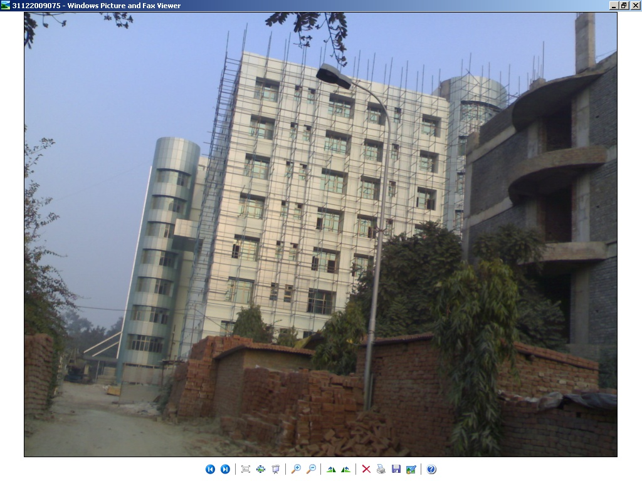
5.6. Site visited Picture to understand the objective work in practical aspect:-
View of Base-Isolated 9 Storey Building Constructed in the Dilshadgarden GTB Hospital Delhi
Fig 5.24

Slide 2
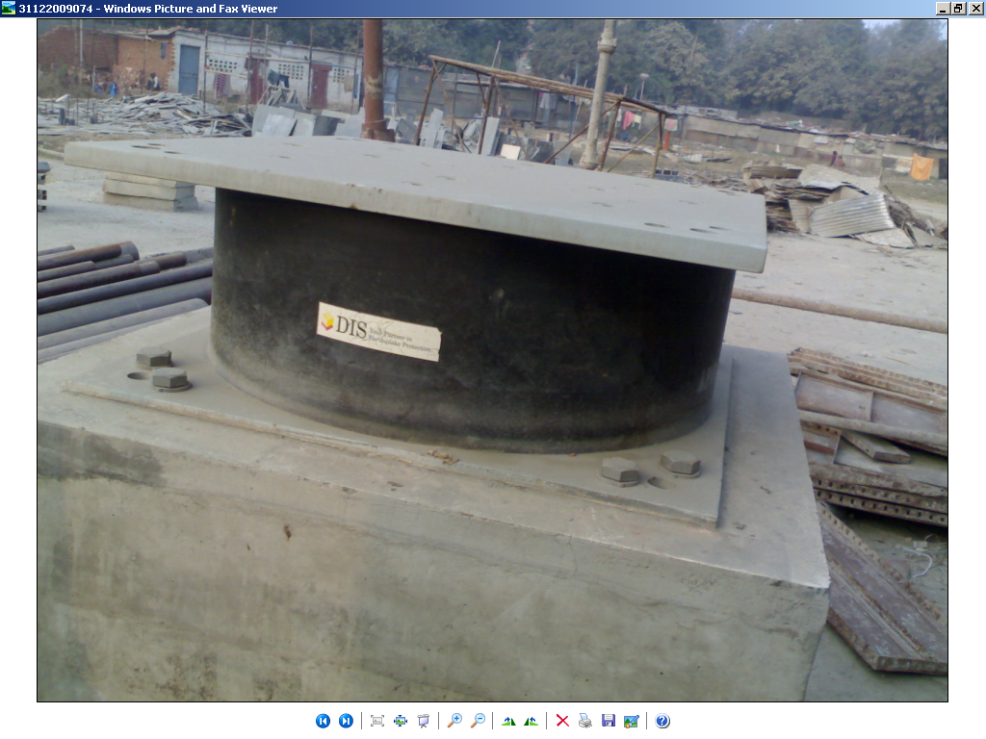
A Prototype View of Lead Rubber Bearing Used in GTB Hospital Base-Isolated Building at Delhi Dilshad Garden
Fig 5.25

Slide 3
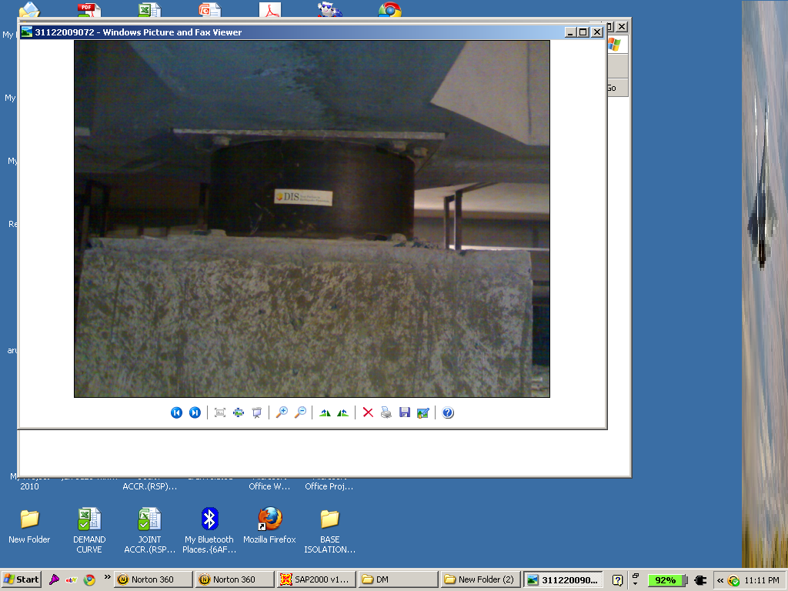
A View of “Lead Rubber Bearing ‘’Installed in Basement at the Junction of Beam-Column in Base-Isolated Building At GTB Hospital Delhi.
Fig 5.26

