Slide 1
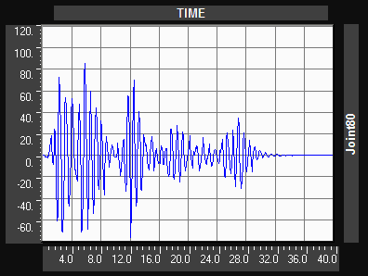
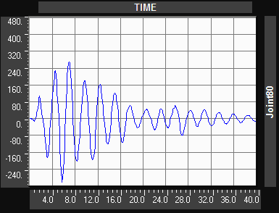
5.7 DISPLACEMENT GRAPHS FOR TH CASE DIFFERENT CASES
Fig 5.23 (a) Top displacement (mm) time history for frame resting on fixed base
Fig. 5.23 (b) Top displacement (mm) time history for frame resting on isolators of uniform stiffness

Slide 2
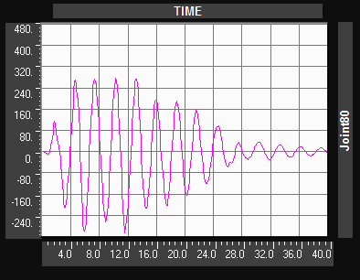
Fig. 5.23 (c) Top displacement (mm) time history for frame resting on isolators of randomly different stiffness
Fig. 5.23 (d) Top displacement (mm) time history for frame resting on isolators of different stiffness in proportion to load coming on the column.

