Slide 1
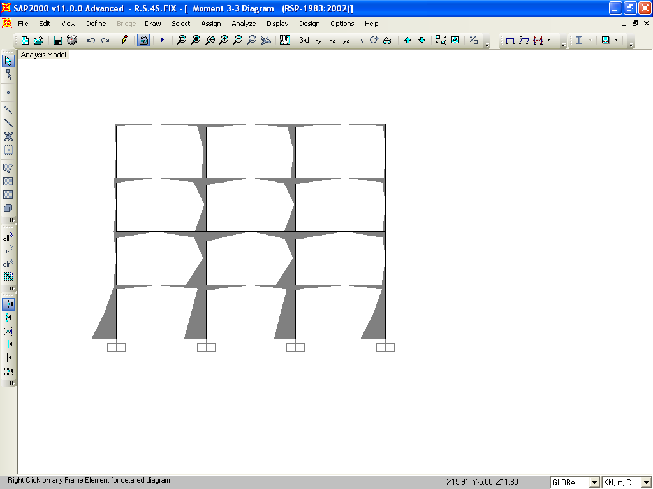
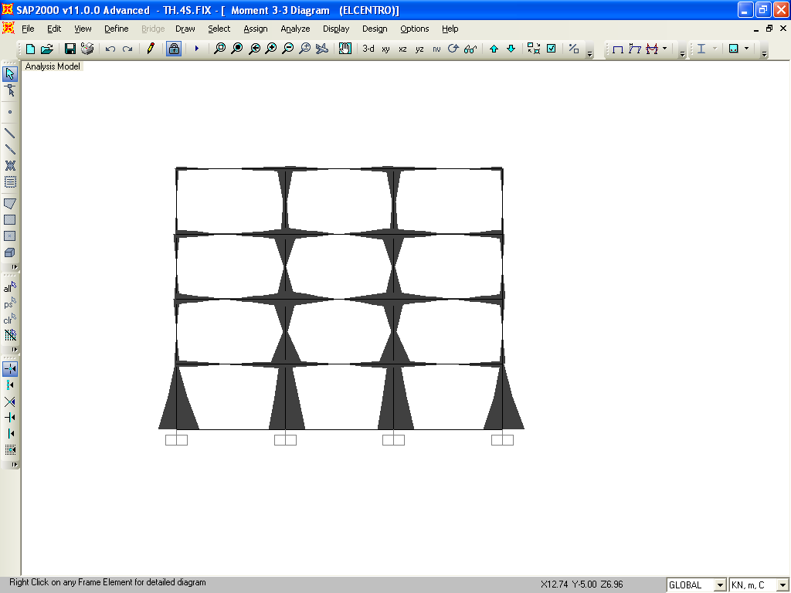
5.6 B.M.DIAGRAM COMPARISION OF RSP & Time History Cases of Fixed of 4, 6 & 9 Storey Buildings
Bending moment variations for fixed frame is as shown in fig. 5.4 (a) & (b) for response spectrum & time history analysis respectively. The values of maximum bending moments (obtained from analysis results for the structure using SAP) are given in Table 5.7 (page 53)
B.M.DIAGRAM FOR 4 STOREY FIXED BASE BUILDING [RSP]
B.M.DIAGRAM FOR 4 STOREY FIXED BASE BUILDING [TH]
Fig 5.20

Slide 2
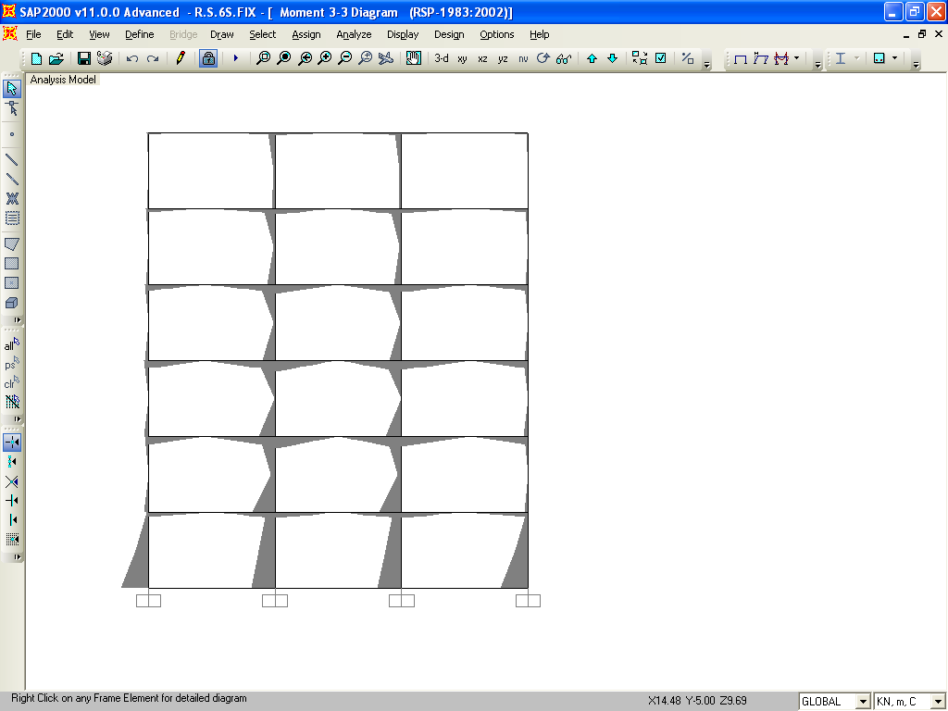
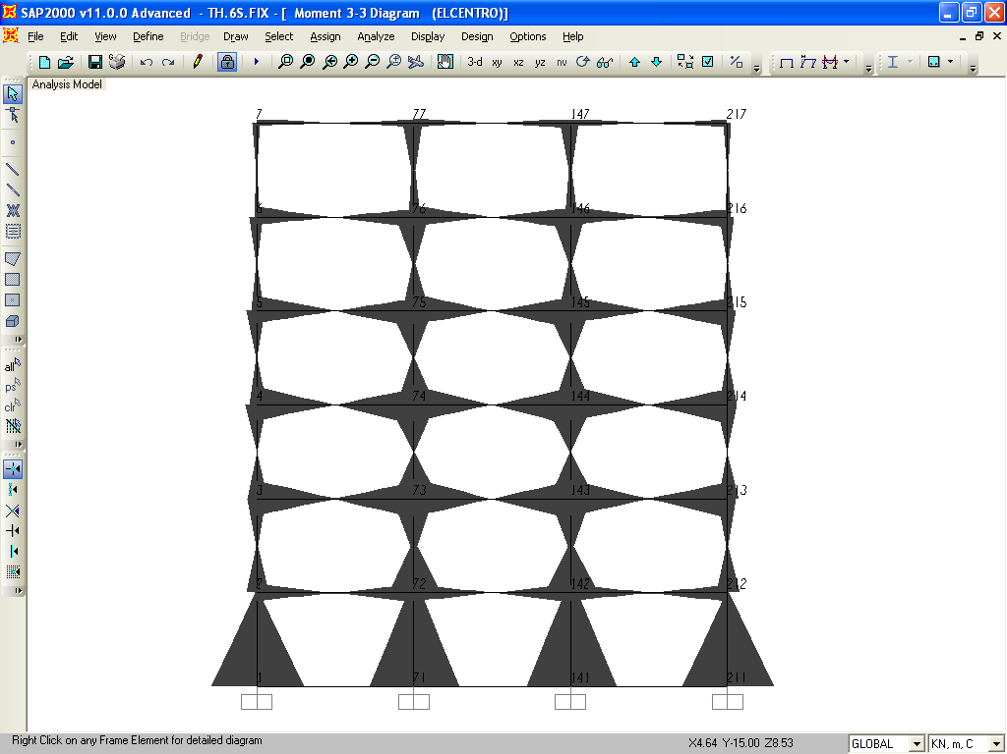
B.M.DIAGRAM FOR 6 STOREY FIXED BASE BUILDING [RSP]
B.M.DIAGRAM FOR 6 STOREY FIXED BASE BUILDING [TH]
Fig 5.21

Slide 3
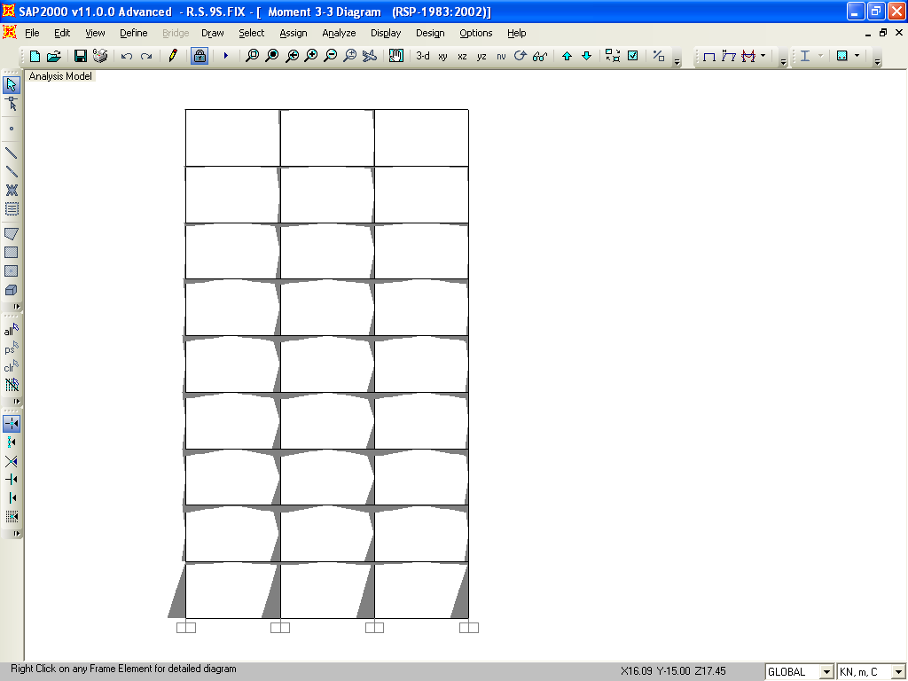
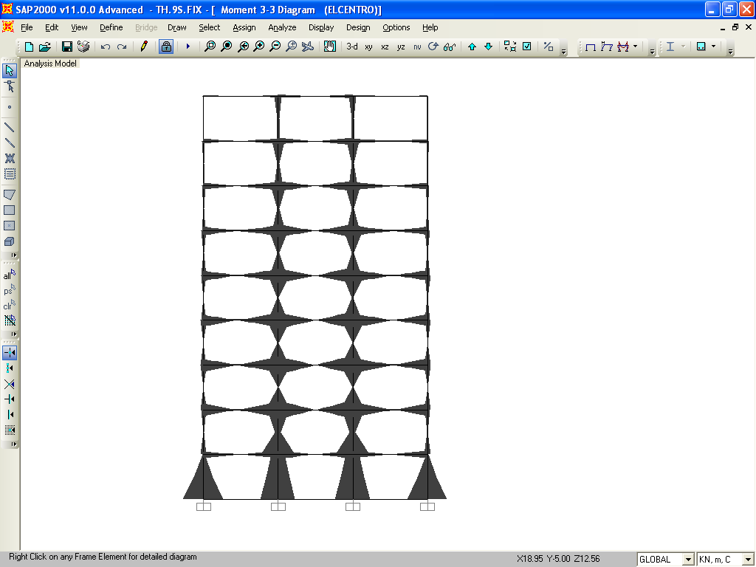
B.M.DIAGRAM FOR 9 STOREY FIXED BASE BUILDING [RSP]
B.M.DIAGRAM FOR 9 STOREY FIXED BASE BUILDING [TH]
Fig 5.22

