Slide 1
1. INTRODUCTION AND LITERATURE REVIEW
1.1 Introduction:
Conventionally, seismic design of building structures is based on the concept of increasing the resistance capacity of the structures against earthquakes by employing, for example, the use of shear walls, braced frames, or moment-resistant frames. However, these traditional methods often result in high floor accelerations for stiff buildings, or large interstorey drifts for flexible buildings Because of this, the building performance may get severely affected during a major earthquake, even if the structure itself remains basically intact. This is not tolerable at cost of losses of life, road and bridges damage and for buildings whose contents are more costly and valuable than the buildings themselves. High-precision production factories are one example of buildings that contain extremely costly and sensitive equipment. Additionally, hospitals, Nuclear Power Plant police station, fire stations, and telecommunication centers are examples of facilities that contain valuable equipment and should remain operational immediately after an earthquake.
In order to minimize interstorey drifts, in addition to reducing floor accelerations, the concept of base isolation is increasingly being adopted. Base isolation (BI) is also referred to as passive control, as the control of structural motions is not exercised through a logically driven external agency, but rather through a specially designed interface at the structural base or within the structure, which can reduce or filter out the forces transmitted from the ground. In contrast, the techniques of active or structural control, which are still under research and development for the seismic resistance of structures, require the installation of some logically controlled external agencies, such as actuators, to counteract the structural motions. One drawback with active control techniques is the relatively high cost of maintenance for the control system and actuators, which should remain functional at all times in order to respond to a major earthquake. There also exists a third category of techniques, called hybrid control, that make use of the best of both control devices.
“The effect of base isolation can be achieved through installation of certain devices between the building and the supporting foundation, so as to separate or isolate the motion of the building

Slide 2
from that of the ground, making them basically uncoupled. The applicability of concept of base isolation need not be restricted to the structure in its entirety. It can be applied as well to the isolation of sensitive equipment mounted inside a building form undesired floor vibrations through, for example, installation of an isolation system between the equipment base and the supporting floor. There are generally two basic approaches to base isolation, which have certain features in common.
One approach is to install some bearings of relatively low horizontal stiffness, but high vertical stiffness, between the structure and its foundation. With such devices, the natural period of the structure will be significantly lengthened and shifted away from the dominant high frequency range of the earthquakes.
Effect of base isolation of structure has shown below figures. 1.1 &1.2
Fig. 1.1) Deformation before base isolation
(Source: “The seismic Design Hand Book,IInd Edition By Farzad Naeim(ed)”

Slide 3
Fig.1.2) Deformation after base isolation.
(Source: “The seismic Design Hand Booking Edition by Farzad Naeim(ed)”
Base-isolation effect also makes a significant effect on the structure’s capacity and demand. The capacity is the expected ultimate strength (in flexure, shear, or axial loading) of a structural component excluding the reduction (φ) factors commonly used in design of concrete members, while demand is a representation of the earthquake ground motion or shaking the building is subjected to.In nonlinear static analysis procedures, demand is represented by an estimation of the displacement or deformations that the structure is expected to undergo. The typical effect of base isolation on capacities and demands is shown in the next fig.1.3

Slide 4
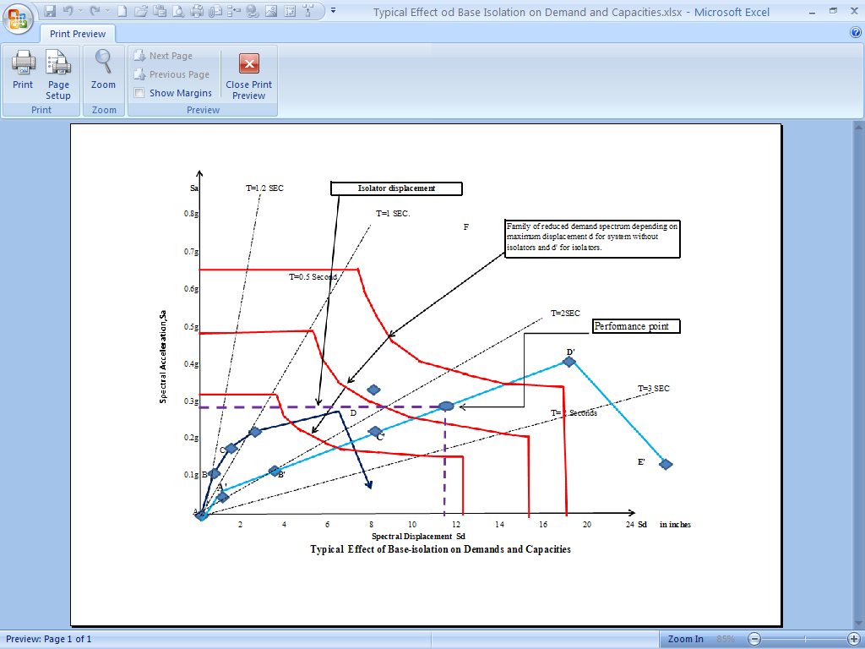
Fig 1.3

Slide 5
In the fig 1.3 curve A-B-C-D-E represents the capacity spectrum for the original, without base-isolated structure, the structure has an initial elastic period of approximately ½ second, and an ultimate deformation capacity of about 7 inches. The first significant yielding occurs at point “B” and the ultimate strength is developed at point D. Curve A-A’-B’-C’-D’-E’ is the capacity curve for the structure with base isolation installed. The yield and ultimate strengths of the structure remain unchanged: however, the displacement at which yielding and ultimate behavior occur are greatly increased by the displacement contribution of isolation bearings. The effective elastic period of the base isolated structure is lengthened to approximately2.5 seconds. Initial yielding of the fixed base structure (point B) occurs at a spectral displacement of approximately ½ inch . For the isolated structure, this same yield behavior (point B’) occurs at a spectral displacement of approximately 4 inches .similarly, ultimate spectral displacement capacity of the structure increases from six inches (point D) to approximately 18 inches (point D’).
1.1.1Philosophy behind Seismic Isolation Systems
When a structure is subjected to a strong earthquake, the system energy of the structure can be conceptually expressed as:
KE + DE + SE = IE Equation…1
Where KE denotes the kinetic energy, DE the dissipated energy, which equals the sum of VE and HE, with VE denoting the viscous energy and HE the hysteretic energy; SE is the stain energy and IE the seismic input energy.
In Equation 1, KE and SE is the portion of the energy of the structure that is recoverable, whereas VE and HE are the portion that is dissipative. For a fixed-base building structure, when IE is not so large, the energy input to the structure will be dissipated in the form of VE. When a strong earthquake occurs, if all the input energy cannot be dissipated by the viscous damping of the structure, then the residual energy will be dissipated in the form of HE. If the structure has been designed to have sufficient ductility, then it may undergo plastic deformations in certain joints, members or specially added components, but the phenomenon of collapse must be avoided. This is the ductility concept of design for the traditional fixed-base structures.
The dynamic characteristics of base-isolated building can be modeled as a single-storey building with a linear isolator. Let us assume that the mass and rigidity of the base-isolated building are

Slide 6
much greater than those of the isolators. By treating the isolated part of the building as a rigid mass, base-isolated building can be simulated as an SDOF system, for which the equation of motion is:
Mű + Cű + Ku = -Mu Equation…………2
Where űg denotes ground acceleration the displacement of the structure, M the mass of the structure, C the damping, u` velocity and K the stiffness of the isolator.
1.1.2 Basic Requirements of Seismic Isolation Systems:
A practical seismic isolation system should meet the following three requirements:
Sufficient horizontal flexibility to increase the structural period and spectral demands, except for very soft soil sites
2. Sufficient energy dissipation capacity to limit the displacements across the isolators to a practical level
3. Adequate rigidity to make the isolated building no different from a fixed – base building under general service loading
Most commonly used seismic isolating systems can satisfy all the above requirements. Certainly, if the seismic isolating system can be equipped with fail-safe devices for avoiding the total collapse of the isolated structure in cases where excessive displacements occur, then the system will most likely be satisfactory.
In other way strategies to achieve seismic isolation includes
1 .Cutting of the load transmission path
2 .Period shifting of structure as shown in below fig 1.4

Slide 7
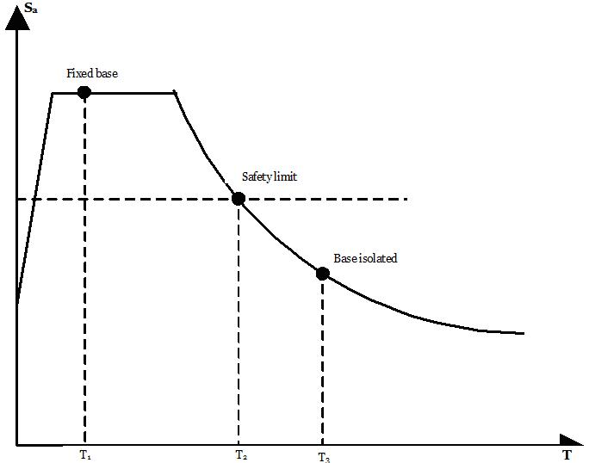
Fig. 1.4) Period shifting in case of base isolation.
(Source: “Design of seismic isolated structures” by Naeim & Kelly)
1.2 Base-Isolation
In the past three decades, the technology of seismic isolation has evolved along the lines of similar principles, resulting in the invention of one isolation device after the other [Johnson and Kiendholz, 1982; Dynamic Isolation System, 1990; Bridgestone, 1990; Earthquake Protection Systems, 1993]. Most of the seismic isolation devices available in the market satisfy the basic requirements identified above, while having their own characteristics. Commercially available seismic isolation systems can be classified according to their dynamic characteristics and how they are formed form individual devices.
India we have Bhuj hospital building which is the only existing seismically isolated building. Two more are in construction phase: (i) A new ward block at GTB (Guru Teg Bahadur) hospital Shadara Delhi, (ii) Shimla hospital building which is done with designs by faculty of IIT Kanpur.

Slide 8
1.2.1 Design Criteria for Isolation devices
A complete design for base isolation should ensure that the isolators can support the maximum gravity service loads of the structure throughout its life, and the isolators can provide that dual function of period shift and energy dissipation to the isolated structure during earthquakes. In accordance e with these design aims, the following design steps should be undertaken [Mayes and Naeim, 2001]:
Determine the minimum plan size required and locations of isolators under the maximum gravity loads
2. Compute the damping ratio of the isolator such that the displacement of the structure can be controlled within the design limit under the wind loads .
3 Determine the damping ratio of the isolator such that the displacement of the structure can be controlled within the design limit under the earthquake loads
4 .Check the performance of the isolators under gravity, wind, thermal, earthquake, and other possible load conditions.
To implement the design procedure for the seismic isolators, three different isolation systems, that is, the high damping rubber bearing, lead-core rubber bearing, and FPS, are considered in this chapter. The primary purpose herein is to illustrate the concepts involved in the preliminary sizing of isolators for a given project.
1.3 Types of Isolation Systems
There are two basic types of isolation systems. They are
Elastomeric Bearings
B .Sliding System

Slide 9
1.3.1 Elastomeric Bearings
The system that has been adopted most widely in recent years is typified by the use of elastomeric bearings, the elastomeric is of either natural rubber or neoprene. In this approach, the building or structure is decoupled from the horizontal components of the earthquake ground motion by interposing a layer with low horizontal stiffness between the structure and the foundation. This layer gives the structure a fundamental frequency that is much lower than its fixed-base frequency and also much lower than the predominant frequencies of the ground motion. The first dynamic mode of the isolated structure involves deformation only in the isolation system, the structure above being to all intents and purposes rigid. The higher modes that will produce deformation in the structure are orthogonal to the first mode and consequently also to the ground motion. These higher modes do not participate in the motion, so that if there is high energy in the ground motion at these higher frequencies, this energy cannot be transmitted into the structure. The isolation system does not absorb the earthquake energy, but rather deflects it through the dynamics of the system. This type of isolation works when the system is linear and even when undamped; however, some damping is beneficial to suppress any possible resonance at the isolation frequency. Some examples of this system are Laminated Rubber Bearing (LRB), New Zealand isolation system (NZ).
1.3.1.1 Laminated Rubber Bearing
An LRB is made of alternating layers of rubber and steel with the rubber being vulcanized to the steel plates. Therefore, the bearing is rather flexible in the horizontal direction but quite stiff in the vertical direction. With its horizontal flexibility, the LRB provides protection against earthquakes by shifting the fundamental frequency of vibration to a much lower value and away from the energy containing range of the earthquake ground motion. The horizontal stiffness of the bearing is also designed in such a way that it can resist the wind forces with little or no deformation. This base-isolation system has been used in a number of buildings in Europe, Japan and New Zealand.

Slide 10
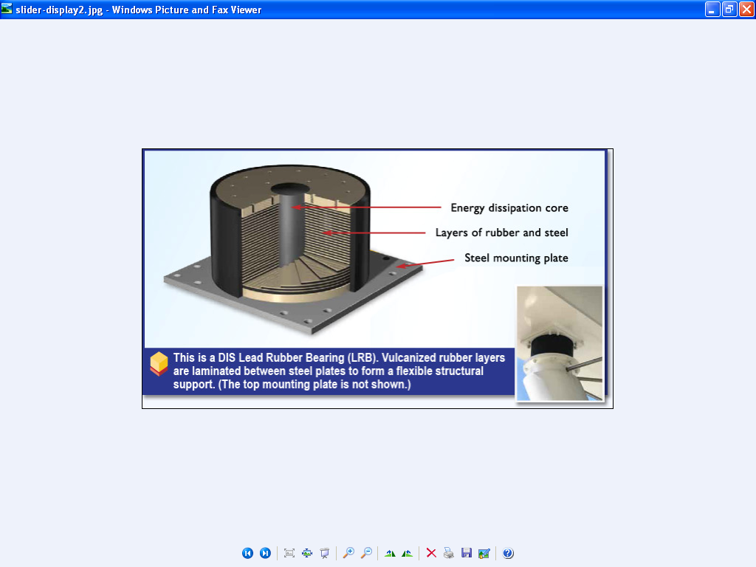
Fig.1.5
(Fig1.5). A PROTOTYPE VIEW OF BEARION USED IN GTB, HOSPITAL, BASE-ISOLATED BUILDING IN DELHI
‘’ From Dynamic Isolation Systems (U.S) Web-site’’
Fig 1.6 Internal construction of laminated rubber bearing

Slide 11
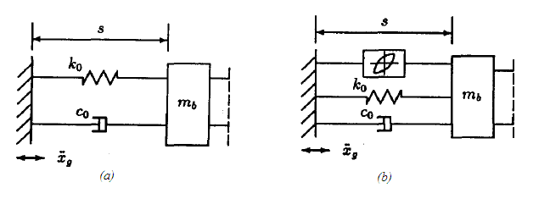
1.3.1.2 New Zealand (NZ) System
A laminated rubber-bearing system in which a central lead core is used to reduce the base relative displacement and to provide an additional mean of energy dissipation has been used widely in New Zealand. This system is referred to as the New Zealand (NZ) base-isolation system. The rubber provides the flexibility for the lateral displacement of the
isolator while the yielding property of the lead core serves as a mechanism for dissipating energy and hence reducing the lateral displacement of the isolator.
Fig. 1.7) Schematic diagram of (a) LRB (b) NZ System.
(Source: “Multi-story base-isolated buildings under a harmonic ground motion - Part I: A comparison of performances of various systems” by Fa-Gung Fan and Goodarz Ahmadi )
1.3.2 Sliding System
The second basic type of isolation system is typified by the sliding system. This works by limiting the transfer of shear across the isolation interface. Many sliding systems have been proposed and some have been used. In China there are at least three buildings on sliding systems that use specially selected sand at the sliding interface.
Base isolators in which the only isolation mechanism is sliding friction are classified as Pure-Friction (P-F) or Sliding-Joint base-isolation systems. In this class of isolators, the horizontal friction force offers resistance to motion and dissipates energy. These isolation devices have no restoring force and residual slip displacement between the structure and the foundation will remain after each earthquake. The examples of isolation devices in this system are Pure-Friction (P-F) or

Slide 12
Sliding-Joint base-isolation system, Resilient-Friction Base-Isolation (R-FBI) system, Friction Pendulum system(FPS).
1.3.2.1 Pure Friction Systems (P-F) / Metallic Roller bearing
Base isolators in which the only isolation mechanism is sliding friction are classified as Pure-Friction (P-F) or Sliding-Joint base-isolation systems. In this class of isolators, the horizontal friction force offers resistance to motion and dissipates energy. These isolation devices have no restoring force and residual slip displacement between the structure and the foundation will remain after each earthquake.
(Fig.1.8) Low friction bearing device (Source: ISET Journal, paper no.545, 2005 by Oliveto & Marletta, university of Catania, Italy)

Slide 13
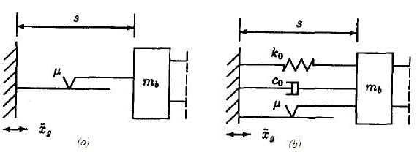
Base-Isolated Building Construction method by the metallic bearing support as a high-performance seismic isolator that could be adapted to skyscrapers and buildings on soft ground, and have employed it for a housing complex (17 stories) in Tokyo.
[ http://www.okumuragumi.co.jp/en/technology/building.html ]
1.3.2.2 Résilient- Friction Base-Isolation (R-FBI)
This isolator is composed of several layers of Teflon-coated friction plates with a central core of rubber. The rubber provides the resilient force for the system while energy is dissipated by the friction forces.
Fig.1.10 schematic diagram of (a) P-F & (b) R-FBI system.
(Source: “Multi-story base-isolated buildings under a harmonic ground motion -Part I: A comparison of performances of various systems” by Fa-Gung Fan and Goodarz Ahmadi)

Slide 14
1.3.2.3 Friction Pendulum System (FPS)
Friction pendulum (FP) isolators are special type of sliding isolator that combines the energy dissipation characteristics provided by friction with the restoring force capability provided by the spherical concave sliding surface.
The isolator assembly consists of a polished stainless steel concave sliding surface and an articulated slider that is coated with a low friction composite material. The radius of curvature of the spherical surface and the desired coefficient of friction between the slider and sliding surfaces are the properties of the FP isolator that are specified by the design engineer. During an earthquake, the articulated slider moves within the spherical surface following the curvature of the surface which results in pendulum motions for the supported superstructure. As such, the period of the isolation system can be calculated based on dynamics of a simple pendulum. An interesting feature of the FP isolator system is that the isolation system period depends only on the radius of the sliding surface and unlike rubber isolators, is independent of the building weight. Due to the curvature of the sliding surface, as the slider moves up the surface during an earthquake, a restoring force is generated that depends on the lateral displacement of the isolator.

Slide 15
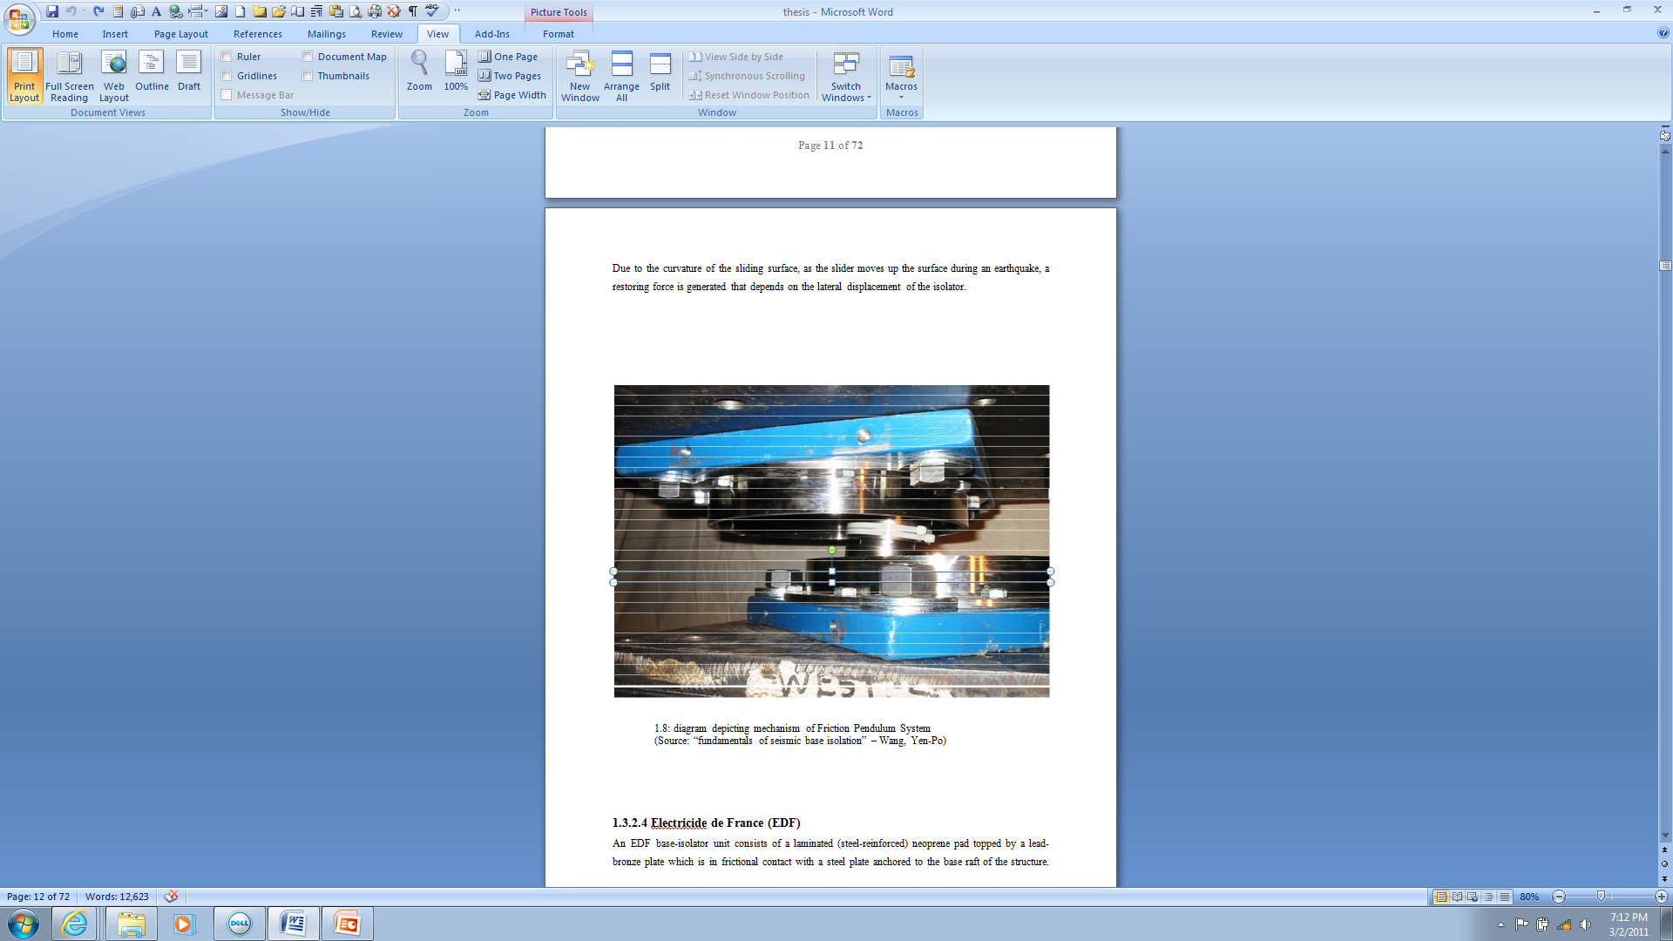
1.8: diagram depicting mechanism of Friction Pendulum System
(Source: “fundamentals of seismic base isolation” – Wang, Yen-Po)
1.3.2.4 Electricide de France (EDF)
An EDF base-isolator unit consists of a laminated (steel-reinforced) neoprene pad topped by a lead-bronze plate which is in frictional contact with a steel plate anchored to the base raft of the structure. . Whenever there is no sliding in the friction plate, the EDF system behaves as an LRB. In this case, the flexibility of the neoprene pad provides isolation for the structure. The presence of the friction plate serves as an additional safety feature for the system. Whenever the ground acceleration becomes very large, sliding occurs which dissipates energy and limits the acceleration transmitted to the superstructure.

Slide 16
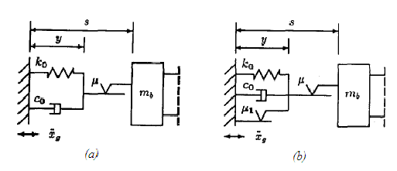
1.3.2.5 Sliding Resilient-Friction (SR-F)
The main feature of this system is the two frictional elements. Whenever there is no sliding in the upper friction plate, the SR-F base isolator behaves as an R-FBI unit. For high intensity earthquake ground accelerations, sliding in the upper friction plate occurs which provides an additional mechanism for energy dissipation and increases the effectiveness of the isolation system.
Fig. 1.12 schematic diagram of (a) EDF & (b) SR-F system
(Source: “Multi-story base-isolated buildings under a harmonic ground motion -Part I: A comparison of performances of various systems” by Fa-Gung Fan and Goodarz Ahmadi)
1.4 SEISMIC RETROFITTING
Different methods for seismic retrofitting of buildings can be grouped under two main strategies. (“Structural Rehabilitation by stiffness strengthening & Base Isolation” by Sachin Pandit, IIT Delhi,2005.
a) Seismic retrofitting (Structural strengthening)
b) Aseismic retrofitting (Force reduction)
1.4.1 Seismic retrofitting (Structural Strengthening)
This method is consistent with conventional seismic design concept of structural strengthening. It involves strengthening of the structure such that it can resist the lateral loads. The strengthening in the buildings can be achieved by additional bracings, shear walls, wall panels, foundations etc. to the building such that the lateral stiffness of the structure is increased. In the field of structural

Slide 17
strengthening the improvement in shear strength of the structural elements is of prime importance, One major group “HILTI”, is there in the field of shear connectors which are extensively being used in structural strengthening.
Fig. 1.9a) Additional foundations.
Fig.1.9b) Additional shear walls.
(Source(Fig. 1.10a & 1.10b): “Methods of seismic retrofitting of structures”web.mit.edu/istgroup/ist/documents/earthquake/Part5.pdf , IST group 2004)

Slide 18
Fig. 1.13c) Jacketing of column. Fig.1.13d) Additional column.
( Fig. 1.13 (c & d) : Conventional Retrofitting techniques)
(Source:: “Methods of seismic retrofitting of structures” web.mit.edu/istgroup/ist/documents/earthquake/Part5.pdf , IST group 2004)
Common conventional techniques for strengthening reinforced cement concrete elements include concrete jacketing, addition of columns, shotcreting/guniting and steel plate bonding and strengthening of beams and columns using new advanced composite materials.

Slide 19
    1.4.2Aseismic retrofitting (Force reduction)
This method is consistent with the aseismic design philosophy. Here the adequacy of the structure for lateral resistance is not important because it is aided by additional devices which take care of the expected seismic forces. This strategy is classified under passive and active control of response of the structure.
‘Base isolators’, ‘Visco-elastic dampers’, ‘friction dampers’, ‘tuned mass dampers’ are examples of passive control. Supplemented damping systems are mechanical devices that can be incorporated in the framed structure and dissipate energy at discrete locations throughout the structure. These devices include either one of the yielding of mild steel, sliding friction, motion of pistons within fluids, orificing of fluid or viscoelastic action of elastomeric materials. Damping devices can provide also supplemental stiffening and strength to structures that lack such properties, in most cases without altering the existing components. All the above techniques have the flexibility to provide either more damping, or stiffness, or both, to better control the interaction with existing components and reduce the seismic demands without modification of the existing structural components.
Active control can be achieved by using ‘accentuated tunes mass dampers’, ‘actuators’ and ‘active tendons’. The principle of the active systems is to provide external corrective forces at strategic points in the structure, to constrain the response within predetermined performance limits. Active bracing systems and active variable stiffness systems are systems built of conventional structural components of structures enhanced with external forces that modify either the effective damping , or the natural frequency of the system to produce more efficient vibration suppression. An active control system is a dynamic system that comprises sensors, controllers, control algorithm and active control force generator which acts as an integral system.

Slide 20
1.5 Applications of base isolation technique worldwide for aseismic retrofitting:
Base Isolation in Japan: The technique is being extensively used in Japan and gained momentum at the most rapid rate there, coz of the lavish expenditures on research in the field of base isolation.
The largest base isolation retrofit work was that of “Buildings 1 through 4 of Mitsubishi Logistics Corporation's Tokyo DIA Building," a complex housing a computer center and data storage facilities” completed in around one year by “Takenaka corporation Osaka”. The retrofitting work was carried out while the computers inside the building were operating for 24 hours a day. In that project 264 rubber bearings and 28 wall type viscous dampers were being used over an area of about 68,000 square meters.
Various other applications were there in Japan: “West Japan postal center, Sanda”, “Matsumura-Gumi Technical Research Institute (Kobe earthquake)” etc.
US applications : Quite a good number of base isolation works r being done in United states : “Foothill communities law and justice centre (FCLJC), Rancho Cucamonga, California”, “Fire Command & Control Facility(FCCF), Los Angeles , California”, “Emergency Operations Center, Los Angeles, California”, “King, Drew Diagnostics Trauma Center, Willowbrook”, “Oakland City Hall”, “San Francisco City Hall”, “Mackay School Of Mines, Reno, Nevada” ,“U.S. Court of Appeals”(FPS Isolators), “San Francisco, California”, “ Los Angeles City Hall”, “Marina Apartments, San Francisco, California” and several others are there.
Base isolation in New Zealand: The first ever base isolated building using lead rubber bearings was “William Clayton Building In Wellington”(1981), other base isolated building are “Union House Auckland” and “Central Police Station, Wellington”.
The structures retrofitted using base isolation are : “National Museum of New Zealand” , “New Zealand Parliament House” and “Printing press Building , Penton.” Etc.

Slide 21
Other than above several examples of base isolation work done are there in Europe (Italy, Calaberia, frigento etc.) and other parts of the world across the globe.
1.6. Base Isolation: Execution of Retrofitting Work
Use of base isolation in seismic retrofitting is a very useful option when the structures are of post-earthquake importance i.e. when structures are supposed to perform well just after the earthquake or even during the earthquake such as hospital buildings or fire stations etc. And to achieve the desired performance level for a structure (isolated) in case of an earthquake as expected from design & analysis, the one aspect of paramount importance is the “installation of isolators”. After going through some of the case studies available for seismic retrofitting using base isolation a sequence for installation and construction is being given here in the following sub-sections.
Retrofitting work using the approach of “Base isolation” when carried out in the field should follow the installation and construction sequence given below:
1.6.1 The installation sequence for a typical LRB into a reinforced concrete column:
(Cetin Yilmaz, Edmund Booth & Chris Sketchley “Retrofit of Antalya Airport International terminal building, Turkey using Seismic Isolation”. Paper no.1259, First European conference on Earthquake Engineering & Seismology. )
Temporary steel columns on suitable foundations are to be installed to either side of the column into which the bearing is to be installed (Figure 1.10). Hydraulic jacks are to be placed at the heads of the temporary columns, bearing onto the soffit of the beams at first floor level, and stressed to a predetermined level, calculated as the gravity load in the permanent column from the analysis (using appropriate software : SAP or ETABS). The hydraulic fluid in the jacks is to be locked off.

Slide 22
Fig. 1.14 Installation of temporary steel props.
(source: Cetin Yilmaz1, Edmund Booth2 and Chris Sketchley3 “RETROFIT OF ANTALYA AIRPORT INTERNATIONAL TERMINAL BUILDING,TURKEY USING SEISMIC ISOLATION” First European Conference on Earthquake Engineering and Seismology, Geneva, Switzerland, 3-8 September 2006,Paper Number: 1259)
Bench marks are to be introduced onto the column just above and below the final position of the bearing, and measurements are to be taken, to enable subsequent checks to be performed of possible movements of the column.
Two horizontal cuts are to be made in the column using a diamond chain saw (Figure 1.15). The block of concrete in between is to be removed (Figure 1.16). The movements of the column above and below the cuts are then to be measured; in most cases this is generally

Slide 23
small, but can reach as much as 6mm. This is considered acceptable. A bed of epoxy mortar is placed on the low half of the cut surface, and the LRB is then rolled into place on steel ball bearings. The gap above the bearing is then filled with epoxy mortar. The hydraulic jacks in the steel props are released and the props are removed after curing of the epoxy mortar
Fig 1.15: Saw cut through the concrete column
(source: Cetin Yilmaz1, Edmund Booth2 and Chris Sketchley3 “RETROFIT OF ANTALYA AIRPORT INTERNATIONAL TERMINAL BUILDING,TURKEY USING SEISMIC ISOLATION” First European Conference on Earthquake Engineering and Seismology, Geneva, Switzerland, 3-8 September 2006,Paper Number: 1259)

Slide 24
Fig 1.16: Removal of concrete block
(source: Cetin Yilmaz1, Edmund Booth2 and Chris Sketchley3 “RETROFIT OF ANTALYA AIRPORT INTERNATIONAL TERMINAL BUILDING,TURKEY USING SEISMIC ISOLATION” First European Conference on Earthquake Engineering and Seismology, Geneva, Switzerland, 3-8 September 2006,Paper Number: 1259)
Steel jackets are welded into place above and below the bearing, and grouted to the column, to accommodate the stress concentrations at the cut surfaces of the column arising from the bearing and to replace the reinforcement that has been cut (Figure 1.15)

Slide 25
Fig 1.17: Steel jackets replacing the discontinued reinforcing bars.
(source: Cetin Yilmaz1, Edmund Booth2 and Chris Sketchley3 “RETROFIT OF ANTALYA AIRPORT INTERNATIONAL TERMINAL BUILDING,TURKEY USING SEISMIC ISOLATION” First European Conference on Earthquake Engineering and Seismology, Geneva, Switzerland, 3-8 September 2006,Paper Number: 1259)

Slide 26
The bearings are wrapped in fire insulation, and brackets introduced to support architectural finishes (Figure 1.14).
Final finishes are then applied.
Fig 1.18: Fireproofing insulation
(source: Cetin Yilmaz1, Edmund Booth2 and Chris Sketchley3 “RETROFIT OF ANTALYA AIRPORT INTERNATIONAL TERMINAL BUILDING,TURKEY USING SEISMIC ISOLATION” First European Conference on Earthquake Engineering and Seismology, Geneva, Switzerland, 3-8 September 2006,Paper Number: 1259)

Slide 27
1.6.2 Jacking and Re-Support of Existing Columns for steel structure:
(Walters Mason, S.E., Principal “The seismic retrofit of the Oakland City Hall”,
Paper no. 10, Forell/Lesser Engineers, Inc., San Francisco, California)
Seismic isolation of an existing steel structure (such as Oakland City Hall) typically involves the complicated task of shoring the existing columns so that they may be cut free from the foundation allowing installation of the new isolator bearings. Extensive sequencing notes are supposed to be developed as part of the shoring design to guide the contractor during the bidding and construction phases.
The sequence notes are supposed to be intended to help preserve the local and global structural integrity of the building to the extent practicable during construction. To achieve this goal, detail requirements for the following topics should be included:
Temporary lateral bracing are required for the basement level during the period of time between structural demolition and final release of the isolator system. Even partial demolition of the perimeter walls during isolator installation may cause a very weak story condition and put the building basement at risk of being damaged during a moderate or major earthquake if no temporary bracing is being provided.
Asymmetric work sequence is required to reduce the possibility of an undesirable torsional response of the structure to an earthquake during the construction period..
The magnitude of jacking loads and load application points are provided on the drawings. Typically, the jacking points are located on new steel framing and corbels welded to the existing columns. The new corbels also serve as permanent column bases after removal of the existing base plates.
Vertical column displacement during jacking is limited in the contract documents to prevent damage to the superstructure finishes. This displacement is measured during jacking operations using sensitive instrumentation.
Submittal and review of the contractor’s detailed construction sequence is required to ensure proper interpretation of the design intent.

Slide 28
2. OBJECT OF PRESENT WORK:
To determine the effects of Base isolation by analysis of fixed and isolated buildings under consideration.
2.Analyzed the isolator for required stiffness and other properties as per column reaction Where isolator to be fixed.
3. To analyze the effect of isolators for different stiffness of a rectangular 4,6 & 9 storied Buildings.
4. To study the effect of non-uniformity in isolator stiffness, on shear in columns of different location at ground storey & torsional coupling of superstructure, for 4 different cases viz : fixed, uniform isolated , with different isolator stiffness & isolator stiffness in proportion of the mass ratio (load coming on each column)
3. EXECUTION OF BASE ISOLATION AND ITS ANALYSIS METHODS AND PROCEEDINGS:
3.1 Base Isolator characteristics
Base isolators are structural members that, like steel beams and columns, are part of a lateral force resisting system that enables a building to respond acceptably to earthquake ground motion. A base isolator has a force versus lateral deflection curve as shown in figure: 3.1;

Slide 29
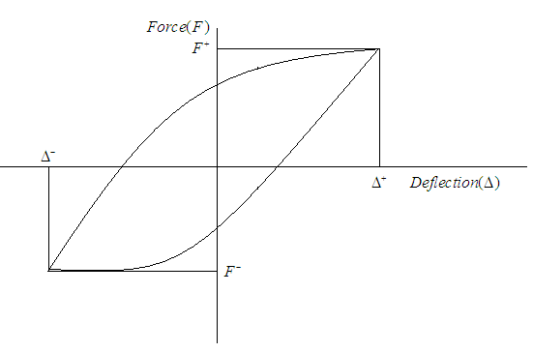
Fig. 3.1) Idealized Force Deflection behaviour of an Isolator
(Source (fig.3.1): “A mathematical hysteretic model for elastomeric isolation bearings” by Hwang,Wu,Pan,Yang (2002): Taiwan)
Two structural design variables are obtained from this force versus deflection curve. The first design variable is the base isolator stiffness (k_{b}), which is defined as
The second design variable is the base isolator viscous damping (ζ_{b}), which is

Slide 30
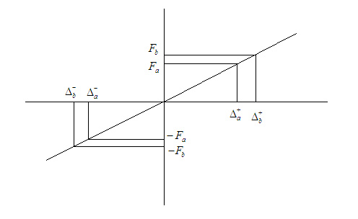
In this equation , F_{max} and ∆_{max} are the maximum absolute values of (F⁺,F⁻) and (∆⁺,∆⁻), respectively. If the damping of the isolator is very small, then the area of the loop is also very small.
The chemical composition of the inner rubber layers used in base isolator determine the lateral force versus lateral deflection characteristics of the base isolator. Base isolator can
be categorized into two main categories on the basis of the force deflection curve, ie linear and Non Linear .A base isolator which is designed such that the line connecting the maximum force point in each cycle is linear is called as a Linear Base Isolator.
Fig. 3.2)Force Deflection curve for a Linear Base
Source (fig.3.2) : (“Base Isolation”, chapter 8, D.G. Hart.)
Base Isolators can also be designed to have envelope force versus deflection curve that are not straight lines but exhibit a non linear behavior. Base isolators designed to exhibit this kind of behavior are called Non Linear Base Isolators.

Slide 31
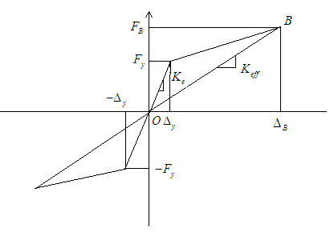
Fig. 3.3.)Force Deflection curve for non linear Isolator
Source : ( ‘‘Base Isolation”, chapter 8, D.G. Hart.)
3.3 Trial Design of Isolator
A structural dynamic analysis of a base isolated structure requires the properties of the base isolator to be specified. Hence, a trial design of the base isolator is performed.
Two approaches can be used to develop a trial design of isolator. (“Base isolation” , Chapter 8th , D.G. Hart )
Method 1:
One method for designing the base isolator is to define the design basis earthquake and then set a value for the period of vibration of the base isolated structure. Selecting a desired natural period of vibration for the base isolated structure is guided by the desire to have “in effect” a rigid structure sitting on base isolators. Hence the natural frequency of the base isolated structure can be given as

Slide 32
Where k_{b} is the stiffness of the isolators under the column and ‘m’ is the mass of the structure. The period of vibration is selected to provide a good separation between fixed base period of vibration, T_{n} and base isolated period of vibration, T_{nb}. Hence we consider a relation T_{nb}= n T_{n} where n is 3 or greater. Using the value of T_{nb}, the value of k_{b} can be calculated.
Alternatively the structural engineer can first set a value of k_{b} and then use the equation to calculate the base isolated period of vibration.
It is important to recall that a positive benefit of using a base isolator is the significant increase in damping of the structure. The damping of a rigid structure sitting on base
isolators is effectively the damping of base isolators. Therefore, a starting value of damping (15-20%) can be assumed for the base isolator, hence the base isolated structure.
Now using the estimated time period of base isolated structure and the respective design response spectrum for assumed damping, the response acceleration (S_{a}) and the response displacement (S_{d}) of the structure can be calculated. The response parameters would be much lower than that of the ‘fixed base’ structure, mainly due to higher time period and higher damping.

Slide 33
Fig. 3.4) Spectral Plot for different damping ratios(according to IS 1893-2002)
Method 2:
In method 1. the intent was for the base isolated structure to have a target natural period of vibration. As a result of this target natural period of vibration selection, the magnitude of displacement of the base isolator and the value of all desired structure response variables follow, using the design basis earthquake and method of structural analysis.
An alternative method can be used, which emphasizes a desired response parameter of base isolator displacement. The desired amplitude of base isolator displacement may be controlled by the open space called gap or moat, around the base isolated building for architectural, mechanical, electrical, or plumbing considerations. Also a variation in this method is to set a value of absolute acceleration of the structure.
This criterion is generally required for buildings, which house sensitive equipments and machineries requiring stringent control on the floor acceleration. Some times, acceleration control may be required for human comfort as well. After the parameter is decided upon, the respective spectrum curve for an assumed high damping (15-20%) is considered for calculating the time period of the base isolated structure.

Slide 34
3.3 Base Isolator Selection
After initial trial design of the base isolator, one needs to select a base isolator for the structure. One can choose from the base isolators available, the one that exhibits similar effective stiffness and assumed damping, for the design pseudo displacement, as considered earlier. It would not be possible to find an isolator that matches the exact requirement, but the one that has closest parameters can be chosen for the structure.
3.4 Preliminary Design of Base Isolated Structure:
Before performing a detailed analysis of the base isolated structure, a preliminary design of the base isolated structure is performed to modify the member size from those of the ‘fixed base’ structure, as the lateral seismic loads on the structure are expected to reduce considerably.
The base isolated structure is designed for the design basis earthquake reduced by the response reduction factor. The response reduction factor is to include the effect of ductility and over strength of the structure. It is important to note that this response reduction factor is different from the factor used in the design of the fixed base structure. This is due to the fact that the expected inelastic response of the ‘fixed base’ structure and ‘base isolated’ structure would be different.
Since, a preliminary calculation of time period and the damping of the base isolated structure have been performed, an approximate value of the time period and the damping of the base isolated structure are known. Hence design spectral acceleration can be found out for the base isolated structure. The base shear of the base isolated structure can be calculated by multiplying the spectral acceleration by the total mass of the structure. The fundamental mode of the base isolated structure would be that of rigid superstructure sitting on flexible base isolator, therefore, the base shear can be equally divided into all floors.
Hence the structure can be analyzed with fixed base and the lateral load applied equally at each floor as calculated above. A preliminary sizing of the sections of the structure can be performed with this analysis.

Slide 35
3.5 Analysis of the Base Isolated Structure
After selecting the base isolator to be used in the structure, a detailed analysis of the base isolated structure is performed to verify that the base isolators selected in the preliminary phase are sufficient. In other words, if the structure is not simplified to a rigid box sitting on top of the base isolators, it will respond with the base isolators in a way that is within the design limit. We can perform a response spectrum analysis or a time history analysis to study the behaviour of the base isolated structure.
3.5.1 Response Spectrum Analysis
In this analysis, the base isolators are considered to be elastic elements with stiffness equal to the effective stiffness of the provided base isolator. In case of a non linear base isolator, the effective stiffness of the base isolator depends upon the lateral displacement of the isolator. Hence, the starting effective stiffness is considered as the effective stiffness for the displacement calculated in the trial design of the base isolator.
Since the damping of the non linear isolator also depends upon the displacement of the base isolator, the effective damping for the displacement calculated in the trial design of the base isolator is considered. For the detailed analysis it can not be assumed that the damping of the structure is same as the damping of the base isolator. Therefore damping of the structure has to be calculated. The effective damping for the different modes is calculated by forming a complete damping matrix (C) of size ‘n+m’ where ‘n’ is the degree of freedom of the structure and ‘m’ is the degree of freedom related to base isolators. The diagonals of the Φ^{T} CΦ give the measure of equivalent modal damping for the analysis. Because the damping in the base isolated building is not classical, the non diagonal terms in the matrix shall not be zero, but they are neglected in the classical modal analysis of the base isolated structure. (Chopra Anil K., Dynamics of Structures: Theory & Application To earthquake Engineering. 2nd edition, Prentice Hall Of India.)

Slide 36
Hence a design response spectra corresponding to the effective damping (fundamental mode) as calculated above is used for the first iteration of the response spectrum analysis. SAP 2000 is used for the response spectrum analysis in this project.
In case of non linear isolators, iterations have to be performed to converge to the final solution. As explained earlier, the effective stiffness and damping were considered for the displacement calculated in the trial design of the base isolator. For the next iteration, the effective stiffness and damping of the base isolated structure shall be considered for the displacement calculated in the previous iteration of the response spectrum analysis. This is required because the effective stiffness and damping are not constant for non linear base isolator but a function of the displacement of the base isolator. The final solution is achieved when the displacements from successive iterations converge.
3.5.2 Time History Analysis
A base isolated structure has non linear base isolators at the base and non proportional damping. Therefore the actual response of the base isolated structure under earthquake can be studied only by a non linear time history analysis.
A non linear time history analysis would show the exact behaviour of the base isolated structure under seismic loads. The non linear time history analysis is performed using SAP 2000.
Time history analysis is used to determine the dynamic response of a structure to arbitrary loading. The dynamic equilibrium equations to be solved are given by:
MX”(t)+ CX’(t)+K(t) = -M {I}a(t)
Where M is the diagonal mass matrix, C is the damping matrix, K is the stiffness matrix, X’’, X’ & X are the accelerations, velocities and displacements of the structure relative to ’a’ which is the ground acceleration due to the earthquake.

Slide 37
3.6 Fixed base structure
Design starts with the specification of a 5 % damped response spectrum for a design basis earthquake. A ‘fixed base’ structure is the structure that would exist if base isolators were not used with the structure and elastic design of this structure is performed for the design basis earthquake where inelastic response parameters are reduced by a reduction factor. This factor includes the ductility effect and the over strength of the structure. The seismic forces on ‘fixed base’ structure are calculated for design response spectrum curve (corresponding to 5% damping) using response spectrum analysis. The stiffness (k) and the mass (m) of the ‘fixed base structure’ are known after the design of the structure. The natural frequency, period of vibration and critical damping ratio for the fundamental mode can be calculated for the ‘fixed base’ structure
3.7 SAP 2000
The analysis and design of the ‘fixed base’ and ‘base isolated’ structure s have been performed using SAP 2000.The various analysis and design features of SAP 2000 used in this project are:
Static linear analysis
Response Spectrum analysis
RCC design by sap 2000(as per UBC/ACI 318)
Non Linear Time history Analysis
The base isolators are modelled through NLLink elements of SAP 2000.A NLLink element is a two-joint connecting link. Each element is assumed to be composed of six separate “springs,” one for each of six deformational degrees-of freedom. All Linear/Nonlinear property sets contain linear properties that are used by the element for linear analyses, and for other types of analyses if no other properties are defined.
Linear/Non linear property sets may have non linear properties that will be used for all non linear analyses, and for linear analyses that continue from nonlinear analyses. Non linear behaviour is

Slide 38
only exhibited during time history analysis. For all other analysis, the link element behaves linearly.
The non linear properties for each NLLink Property must be of one of the various types described below. The type determines which degrees of freedom may be non linear and the kinds of non linear force- deformation relationships available for those degrees of freedom.
For each non linear type of NLLink Property, there are six uncoupled linear effective-stiffness coefficients, K_{e}, one for each of the internal springs. The linear effective stiffness represents the total elastic stiffness for the NLLink element that is used for all linear analyses that start from zero initial conditions.
For each non linear-type of NLLink Property, there are six uncoupled linear effective-damping coefficients, C_{e}, one for each of the internal springs. By default, each coefficient C_{e} is equal to zero. The linear effective damping represents the total viscous damping for the NLLink element that is used for response-spectrum analyses, for linear and periodic time-history analysis. Effective damping can be used to represent energy dissipation due to non linear damping, plasticity, or friction.
For the non linear analysis, the plasticity property used for non linear analysis of the link element is based on hysteretic behaviour proposed by Wen (1976). (Fig.3.5)

Slide 39
Fig.3.5) :Nonlinear Behaviour of NLlink element in SAP 2000
( Source: SAP Analysis reference manual, page no. 242, CSI, Berkeley, January 2007)
The non linear force-deformation relationship is given by:
f  ratio k d (1 ratio) yield z
where k is the elastic spring constant, ‘d’ is deformation, yield is the yield force, ratio is the specified ratio of post- yield stiffness to elastic stiffness (k), and z is an internal hysteretic variable. This variable has a range of | z | 1, with the yield surface represented by | z | 1. The initial value of z is zero, and it evolves according to the differential equation:
Where ‘exp’ is an exponent greater than or equal to unity. Larger values of this exponent increases the sharpness of yielding. The practical limit of exp is about 20.
3.8 UBC 97 – Base Isolation Design Specifications
One of the few codes which provide the guidelines for design of base isolated structure is Uniform Building Code (UBC) 1997.A summary of the regulations given in the UBC is given below.

Slide 40
The code recommends that the base isolated structure and the base isolator may be designed for the design basis earthquake, where the design basis earthquake is defined as that ground motion that has a 10% chance of being exceeded in 50 years. Whereas the stability of the base isolator may be checked for Maximum Capable earthquake, where the Maximum Capable earthquake is defined as that ground motion that has a 10% chance of being exceeded in 100 years. As per the code, the design basis earthquake shall be used to calculate the total design displacement of the isolation system and the lateral forces and the displacements of the isolated structure. The maximum capable earthquake shall be used to calculate the total maximum displacement of the isolation system.
The fixed base structure is designed to withstand the lateral displacements induced by the design basis earthquake, considering the inelastic response of the structure, inherent redundancy, over strength and ductility of the lateral force resisting system. The lateral forces are reduced by a response reduction factor ‘R’ for the elastic design of the structure and by modified response reduction factor ‘for the design of base isolated structure. However, the base isolator and the structure below the base isolation system shall be designed for the design basis earthquake without any reduction in the lateral forces
’
3.9 Approximate structural performance/target performance points:
Most base isolated building has a period that rages between two to three seconds and effective viscous damping ratios that range from fifteen to twenty five percent. Consequently, in order to perform a preliminary design for base-isolation it is convenient to assume that the base isolated structure will have an effective period of 2.5 seconds and an effective damping of twenty percent. By overlaying the capacity spectrum developed for without base isolated structure with an approximate demand curve for 20 percent effective viscous damping, it is possible to evaluate the feasibility and requirement for a base isolated design. The fig.22

Slide 41
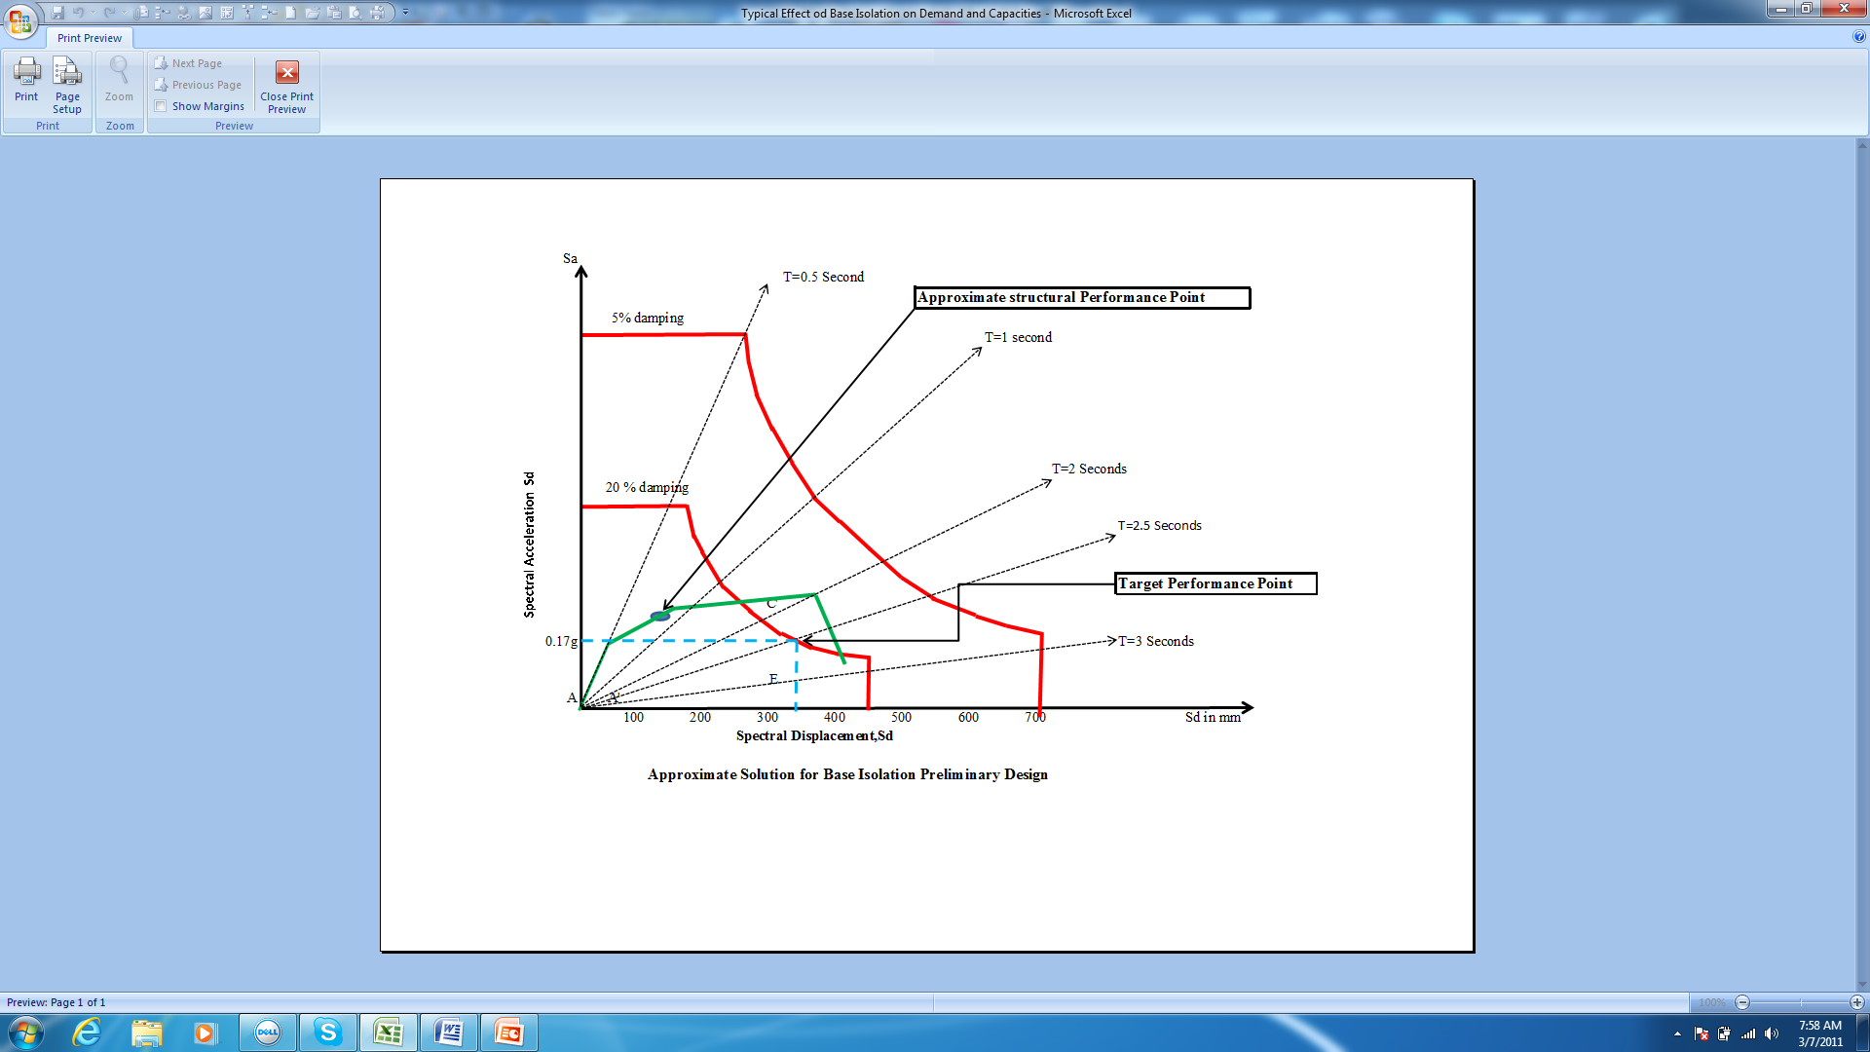

Slide 42
In the project analysis of performance points done in the sap 2000 .for 4, 6 & 9 storeys buildings. The graphs for each type of building are represent the Base shear, displacement, acceleration spectrum, displacement spectrum, effective time and effective damping at performance points. Graphs are shown in the results sections.

Slide 43
4. Numerical Study
4.1 General Study parameters
The present study has been carried out to study the “Study of Base-Isolation Systems & retrofitting”.
3D Analysis of an rectangular 4,6,&9 storey, frame with dimensions as given in 4.2.1, is being done in the present work for 4 different cases, as follows:
1. Fixed base frame with no isolators.
2. Isolated frame with all isolators of uniform stiffness.
3. Isolated frame with isolators of randomly different stiffness.
4. Isolated frame with isolators of different stiffness, Isolator stiffness in proportion of the load coming on the individual column (or in proportion to mass ratio).
The analysis is carried out, Then results are compared for the above 4 cases, basically the base shear in the ground storey column of some particular locations are being compared to observe the difference in the ratio of those base shear values.
Isolators used for isolation are laminated rubber isolators, & they are of linear type. Modelling and analysis of the frame is being done in SAP-2000 Version-11 (Advanced) using both response spectrum (IS 1893:2002) and time history (EL-Centro NS component).
.
The base isolators are being chosen from the available isolators as per the requirement of the structure. And in response spectrum analysis: the damping of isolators is only assumed to be the damping of the structure, because there will not be any additional damping, the isolator being linear.
Various steps involved are as follows:
Analysis of fixed base 3-D RCC Rectangular frame for dead and seismic loads
Analysis of above frame for: (1.) seismic loading as per IS 1893-2002 response spectrum &

Slide 44
(2.) An arbitrarily chosen time history loading (EL-Centro 1940).
Modelling of the above frame: (1.) With isolators of uniform stiffness below each column
(2.) For isolators of randomly different stiffness. &
(3.) For the stiffness of isolators in proportion to the load coming on the individual column.
Response spectrum analysis of above all three “Base isolated frames” for IS 1893-2002 response spectrum seismic loading.
Nonlinear time history analysis of above all three “base isolated 3-D frame” using EL-Centro -1940 NS component.
Location of isolators shown in the fig. 4.1
X_{i =} Distance of ith isolator along X-axis. (As shown in fig. 4.1)
Y_{i} = Distance of ith isolator along Y-axis (As shown in fig. 4.1)

Slide 45
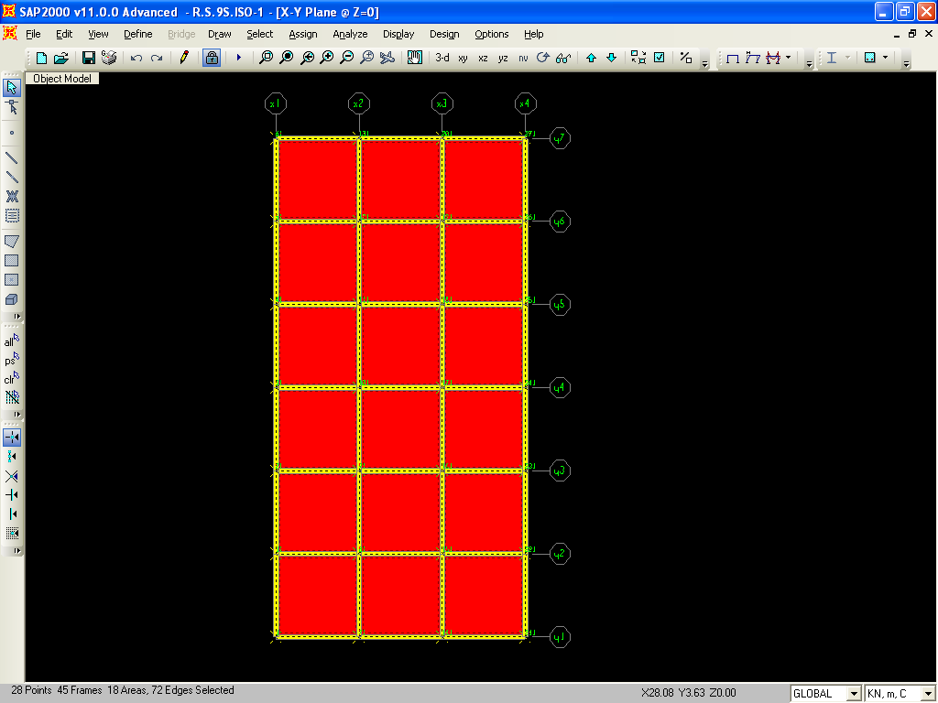
30.00 m
15.00 m
Fig. 4.1: Plan of the Rectangular frame showing Xi & Yi. & Locations of Bearings.

Slide 46
4.2 Numerical Example:
4.2.1 Dimensions of 3D frame:
Isometric view, Top view & Elevation of reinforced cement concrete, (G+8) storey frame are as shown in the Fig. 4.2 & Fig. 4.3 & Fig. 4.4 respectively.
The storey height= 3 m for ground, and above ground also 3m are being modelled in SAP-2000.
Sizes of the structural members are as follows:
Beam size: 600 mm x 300 mm.
Ground storey column size 900 mm x 900 mm.
Above ground storey, the col. sizes are
(A) other than corner’s columns, peripheral col. Are 300 mm x600 mm & 600mm x300mm
(b) Corner’s columns sizes are 400mm x 400mm
(c)Balance all the columns are kept of sizes of 600mm x600mm
Roof slab, all other slabs: 150 mm thick.
The beam & column sizes are kept same for both fixed and isolated frame.
Modulus of Elasticity = 2485578 KN/M^2
Poison Ratio 0.2
Weight per unit 23.5631 KN/M^3
Isometric view, Top view & Elevation of reinforced cement concrete, 4,6 & 9 storey frame are as shown in the Figs. Ahead

Slide 47
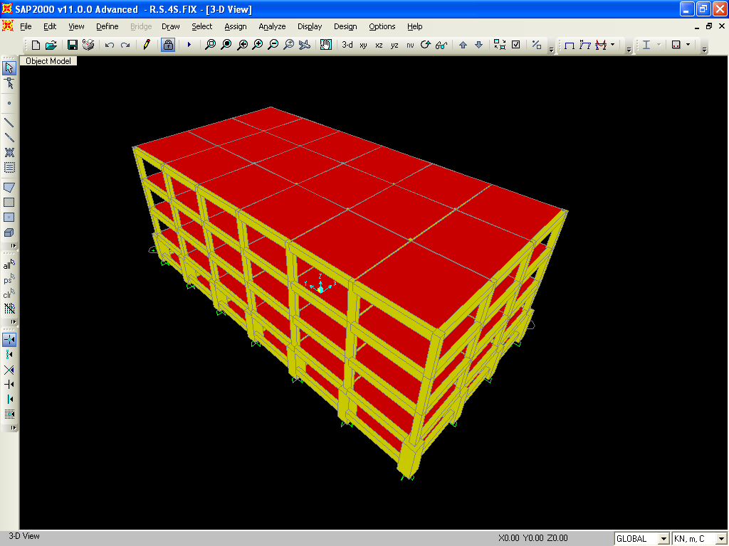
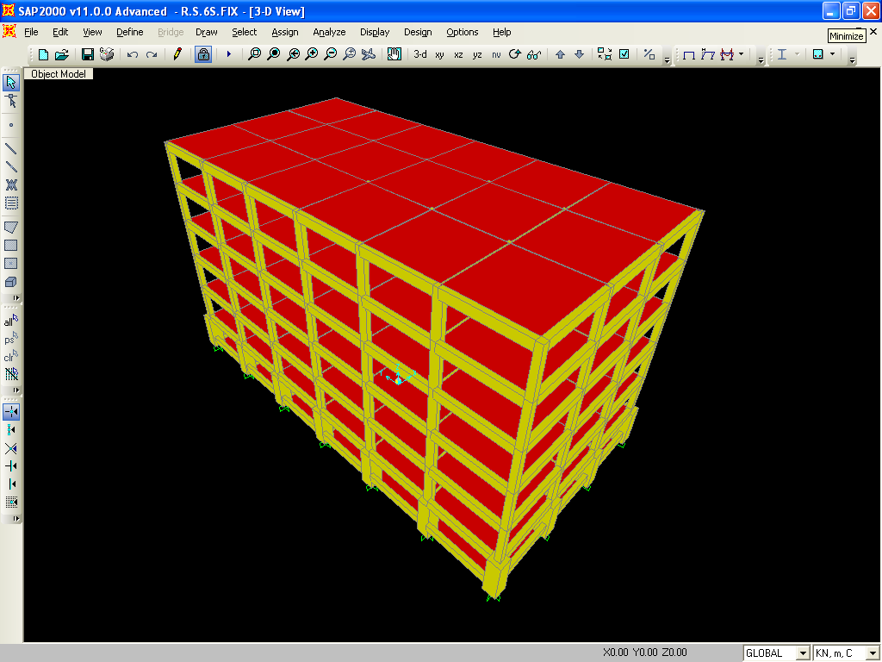
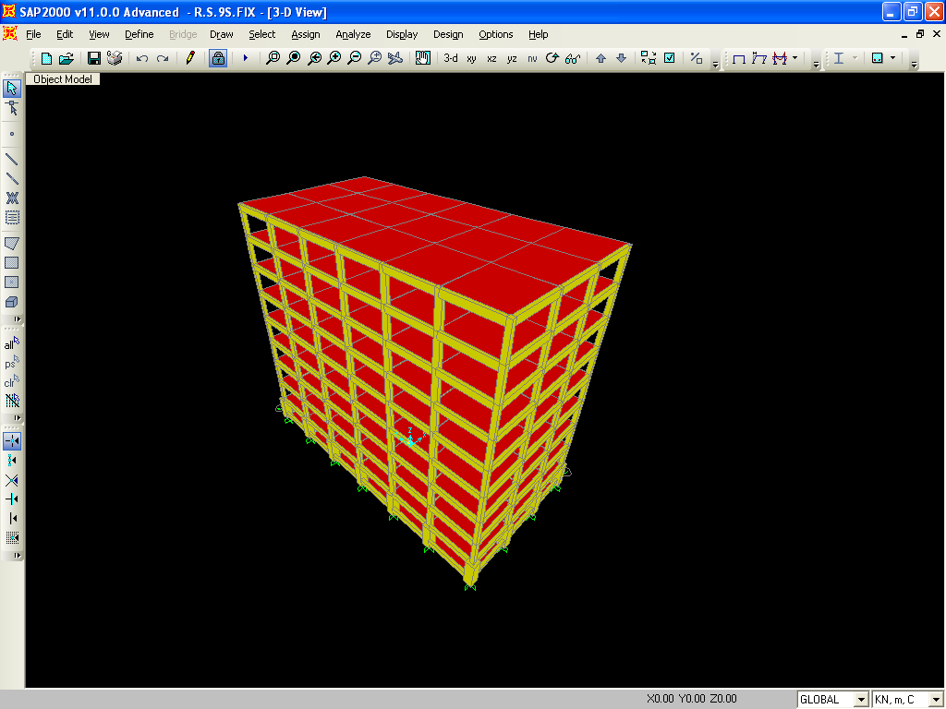
A
B
C
Fig. 4.2: Isometric view of 4,6 & 9 Storey Rectangular Frame Structure Represented by A,B & C

Slide 48
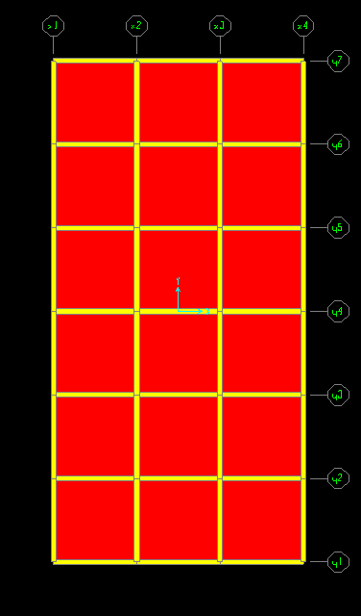
Fig. 4.3 Top view of the Rectangular Building

Slide 49
4.2.2 Isolator properties:
Laminated rubber isolators of linear type are being used in this analysis. Properties of the isolators used in this project are on the basis of the analysis used by ‘Dynamic Isolation Systems’ in the building constructed for GTB, Hospital in Dilshadgarden,Delhi. The analyses of three types bearings are analyzed separately in excel and results of analysis are as follow
1. For uniform isolator stiffness case: (RUB1)
Effective stiffness in vertical direction =2234134 KN/M
Effective stiffness in horizontal direction = 980 KN/M
2.) For different (randomly) isolator stiffness case:
Isolator 3 (RUB 3): Placed at the base of columns: - x1y7, x4y7, x1y1 & x4y1 (Fig. 4.3)
Effective stiffness in vertical direction = 1102057KN/M
Effective stiffness in horizontal direction = 604 KN/M
Isolator2(RUB 2):Placed at the base of columns :-x2y7,x3y7, x4y6,x4y5,x4y4,x4y3,x4y2, x1y6,x1y5,x1y4,x1y3,x1y2x3y1,x2y1 (Fig. 4.3)
Effective stiffness in vertical direction = 1833383KN/M
Effective stiffness in horizontal direction = 920 KN/M
Isolator 3 (RUB 3): Placed at the base of column.-x2y6, x3y6, x2y5, x3y5, x2y4, x3y4, x2y3, x3y3, x2y2, x3y2. (Fig. 4.3)
Effective stiffness in vertical direction = 2234134 KN/M
Effective stiffness in horizontal direction = 980 KN/M
3.) For isolator stiffness in proportion of mass ratio:
Isolator 1 (RUB1): Placed at the base of columns: - x1y7, x4y7, x1y1 & x4y1 (Fig. 4.3)
Effective stiffness in vertical direction = 1102057 KN/M
Effective stiffness in horizontal direction = 604 KN/M

Slide 50
Isolator 2 (RUB2): Placed at the base of columns: x2y7, x3y7, x4y6, x4y5, x4y4, x4y3, x4y2, x3y1, x2y1 (Fig. 4.3)
Effective stiffness in vertical direction = 1833383KN/M
Effective stiffness in horizontal direction = 920 KN/M
Isolator 3 (RUB3): Placed at the base of column: x2y6, x3y6, x2y5, x3y5, x2y4, x3y4, x2y3, x3y3, x2y2, x3y2. (Fig. 4.3)
Effective stiffness in vertical direction = 2234134 KN/M
Effective stiffness in horizontal direction = 980 KN/M
Detailed analysis of isolator’s properties, fixed at aforesaid locations is as follows

Slide 51
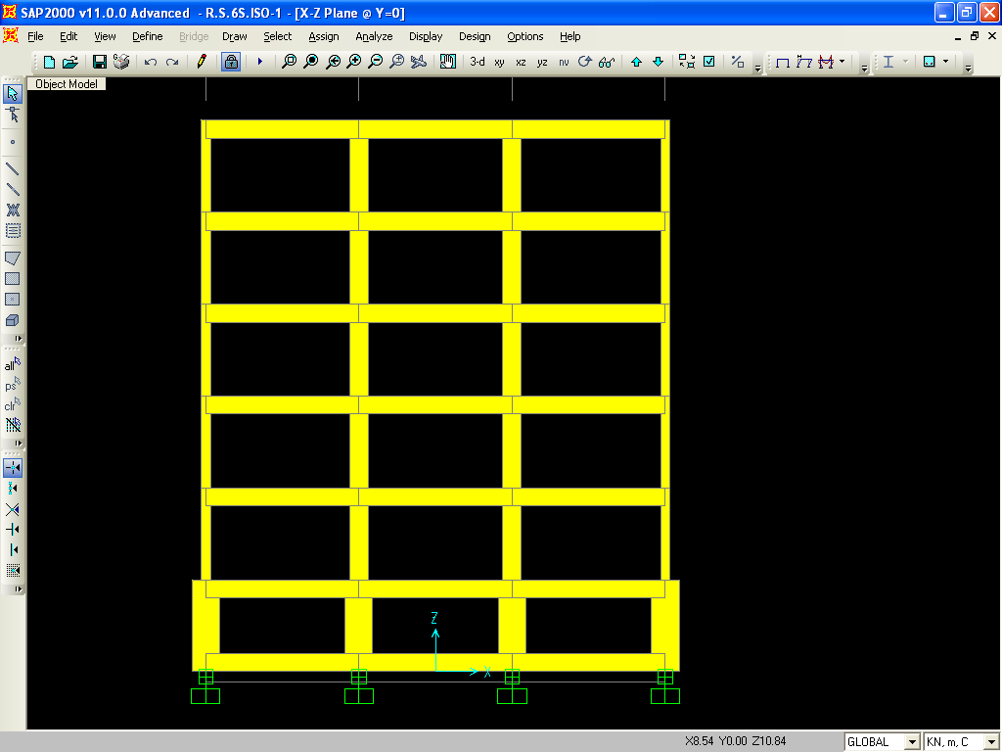
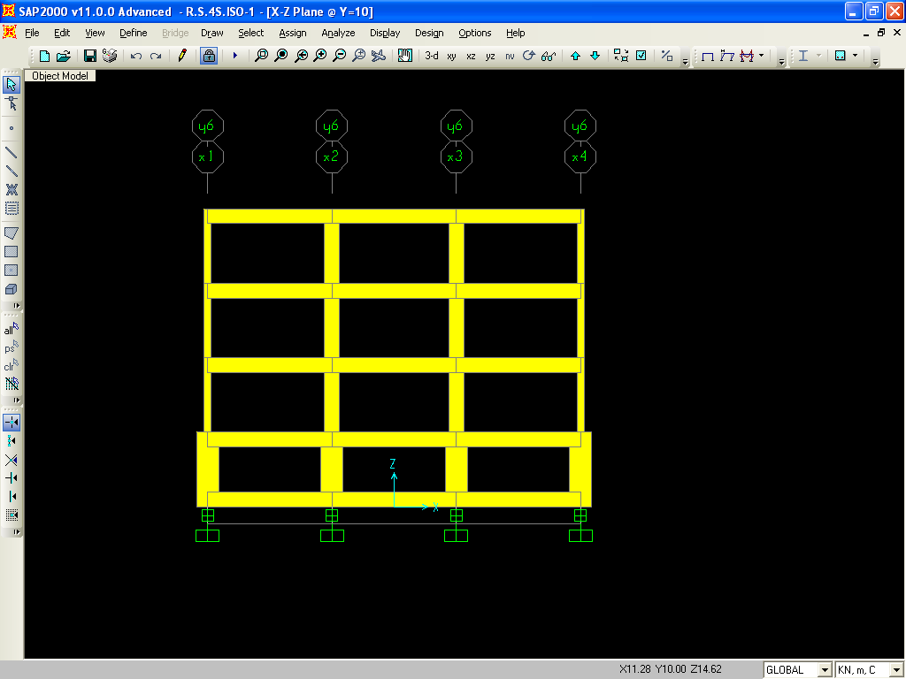
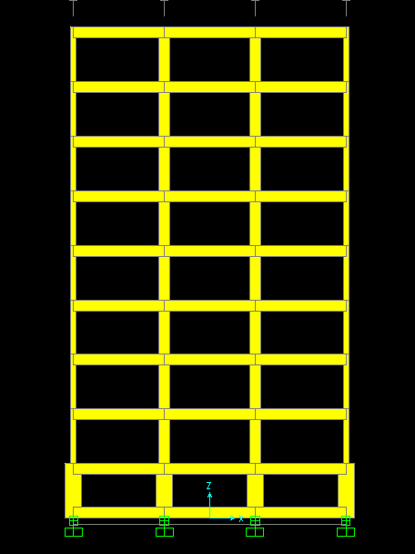
A
B
C
Fig. 4.10: Elevation of Isolated (ZY View) 4, 6 & 9 storey Building frames shown by A, B & C

Slide 52
4.2.3 Seismic loading:
For response spectrum analysis, the response spectrum given in IS 1893-2002 for Delhi (zone IV, Z= 0.24) and medium soil (Type II) is being used for seismic loading. Damping in analysis for both fixed base & base isolated structure is taken as 5 % as the default value in IS 1893-2002 response spectrum Linear isolator is being used so no additional damping will be there due to the damping of isolator.
For time history analysis , the time history of NS component of El-Centro -1940 earthquake having peak acceleration value as 0.3188g at around t=2.5 sec. is being used as exciting ground motion. Graphical plot of this time history data is as shown (fig. 4.6). No response reduction factors are being applied since here the purpose is just to compare the responses for different cases of isolated structure considered. Otherwise if response reduction factors are to be used then R=3.5 for fixed base and R=2 (modified) for isolated structure is to be used as per UBC 97. Application of “R” is prohibited in zone IV & V as per IS 1893-2002.
Fig. 4.11 : Plot of El-Centro time history NS component -1940
(source: www.csiberkeley.com )

Slide 53
5. RESULTS & DISCUSSION:
Analysis of the frame under consideration as described in numerical study is being done using SAP 2000 Ver. 11 (Advanced) for all the four cases :
1.) Fixed base frame with no isolators.
2.) Isolated frame with all isolators of uniform stiffness.
3.) Isolated frame with isolators of randomly different stiffness.
4.) Isolated frame with isolators of different stiffness, stiffness being in proportion of the load coming on the individual column (or in proportion to mass ratio).
As analysis results, the values of fundamental time
period (for 1st mode) of the structure, Column shear for particular ground storey columns (Columns with extreme values of column shear): x1y6, x6y6, x1y1, x6y1 (as shown in plan in fig. 5.1) and base & top displacement ( i.e. absolute and relative displacements) are obtained for all four cases, (1,2,3,4) using modal & both response spectrum and non-linear time history analysis. And after analysis the displacement time histories for top displacement are obtained. All above results are obtained directly from SAP.

Slide 54
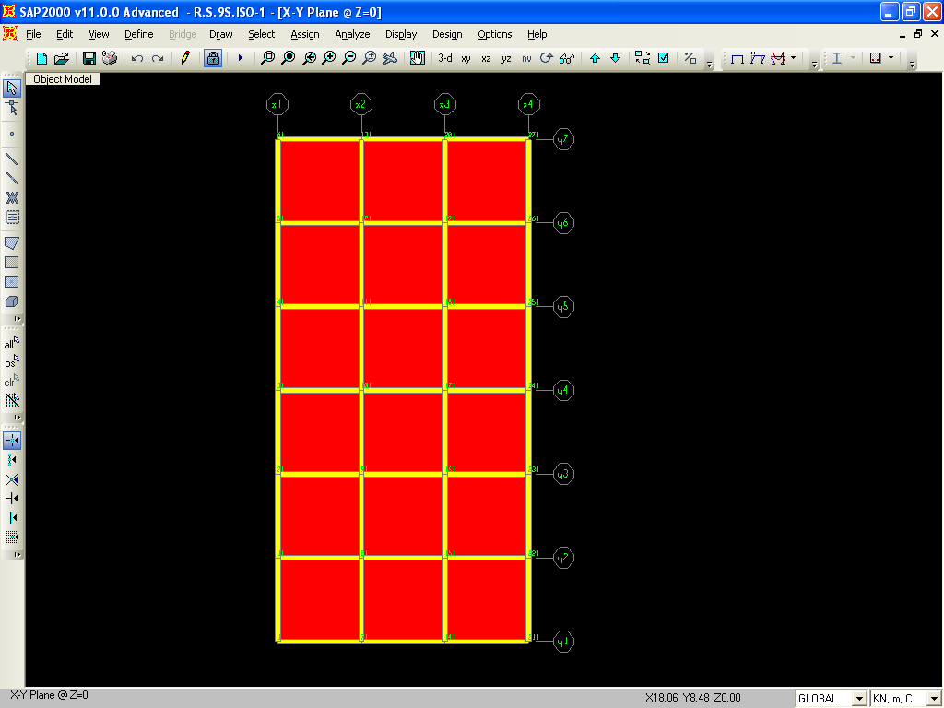
LOCATION OF SF & BM NOTED IN OBSERVATION SHEET
M1
M2
M3
M4
C1
C2
C3
C4
Fig. 5.1: Plan specifying locations where S.F & B.M‘s Values entered in observation tables.

